Slide 1


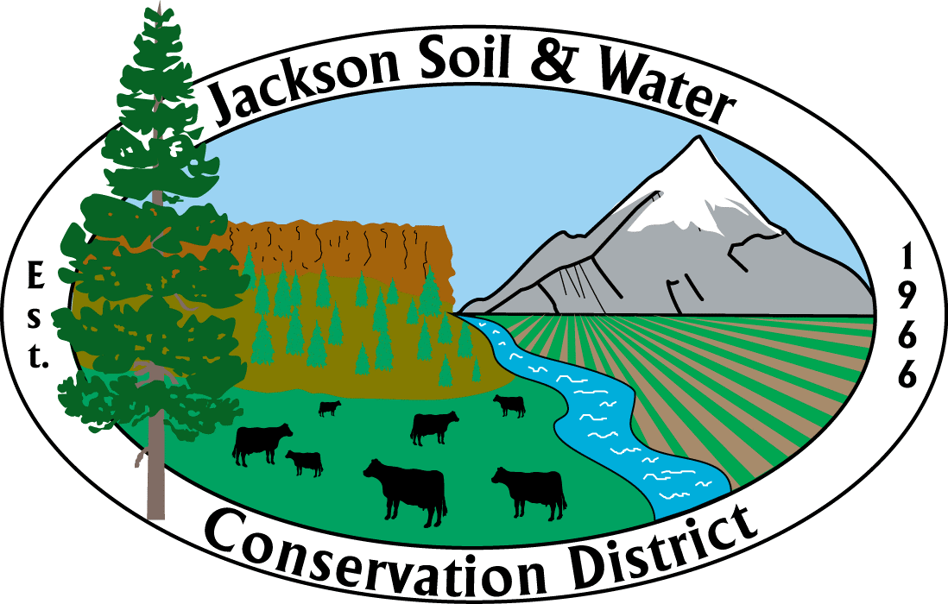
Irrigation Management and Efficiency
February 3rd, 2024
Applegate Water Security Education Day
Paul DeMaggio, P.E., CID, CAIS
Water Resources Engineer
Jackson Soil and Water Conservation District

Slide 2
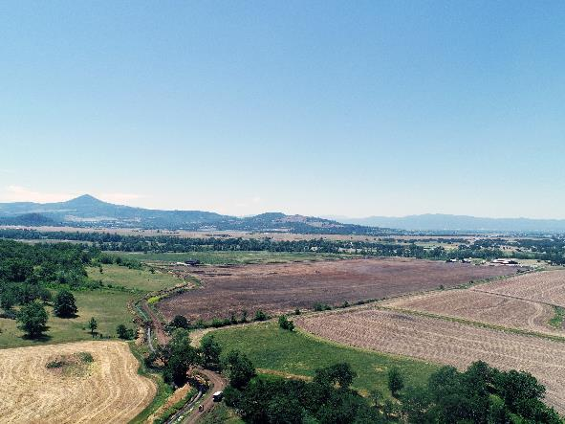
Presentation Summary
Agricultural Water Resource Management Terms
Optimizing Irrigation Water Use
Irrigation System Improvement Options – Ditches and On-Farm
Agricultural Water Quality
Funding and Programs

Slide 3
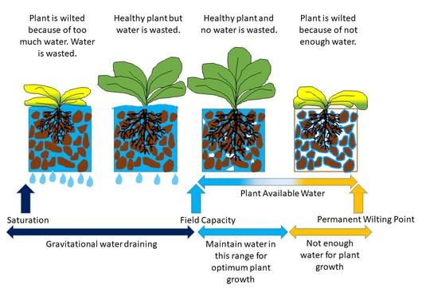
Irrigation Water Management
(Irrigation Scheduling)
When to start irrigation?
  Soil Moisture
How many hours to irrigate for?
  Depends on many factors.
Blog.lib.umn.edu

Slide 4
Irrigation Water Management (Ditches, Conveyance, Diversions)
When to open the headgate?
  Soil Moisture
  Predicted Crop needs in the next week based on crop type and weather
How much water to divert down the ditch?
  In reality, this is the water right and the RATE stated on the water right documents.
  In theory, this should be based on Acres actively irrigated. Not the Acres on paper.
When and how long does each user get to irrigate? Rotation Schedule or On-Demand Schedule?
How much water to release from the Reservoir for use downstream?
Notes:
80 Acres of Hay
May is about 0.18 inches of Etc per day.
100% efficient system = 0.6 CFS per 80 Acres.
60% Efficient system = 1 CFS per 80 Acres. (1/80th CFS per Acre)
July – 0.27 inches of Etc per day.
60% efficient system = 1.5 CFS per 80 Acres. (1/60th CFS per Acre

Slide 5
Irrigation Efficiency On-Farm
(more crop per drop)
Water Used (by the intended crop) / Water Applied
Important to be as efficient as possible and to use water without excessive waste
Inefficiencies caused by:
  Runoff
  Water ‘lost’ below the root zone (overwatering)
  Evaporation off the soil and plant surfaces
  Wind drift
  Water use by weeds
Inefficient Irrigation Can lead to:
  Erosion
  Runoff of fertilizer and nutrients into waterways or into groundwater
  Poor crop yields
On-farm VS Basin Wide efficiency.

Slide 6
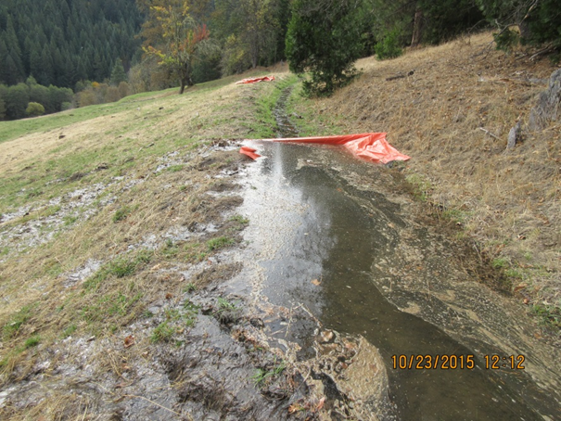
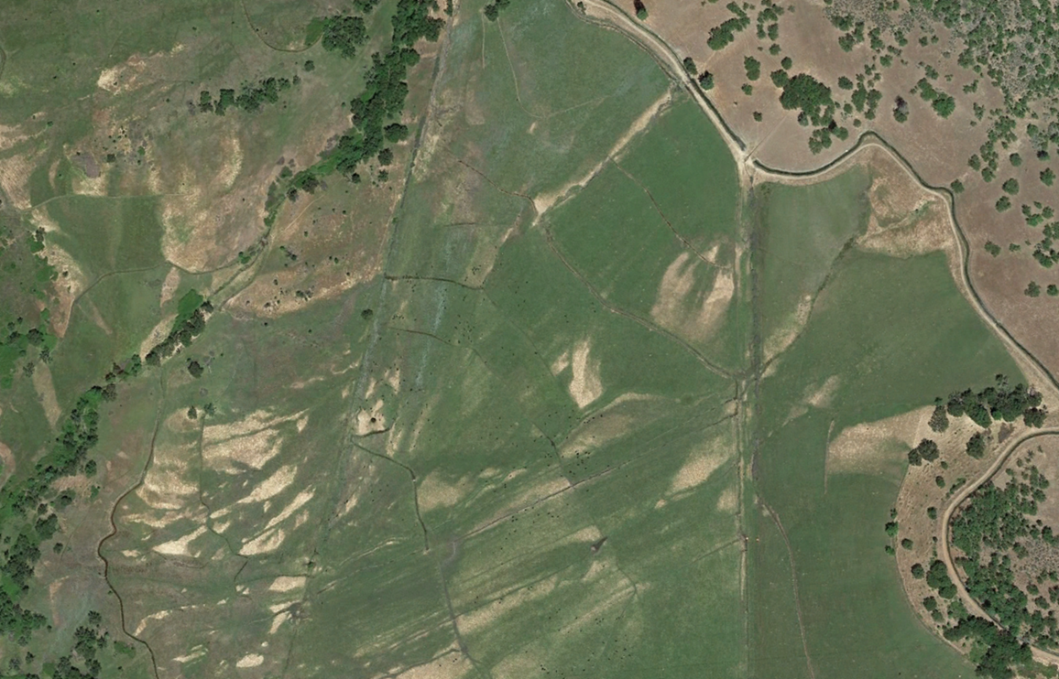
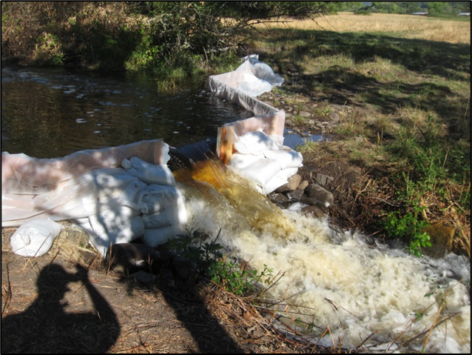
Inefficient On-farm Irrigation
‘Contour Flood Irrigation’
Flood irrigation on uniformly graded land with good management can have very high efficiency!

Slide 7
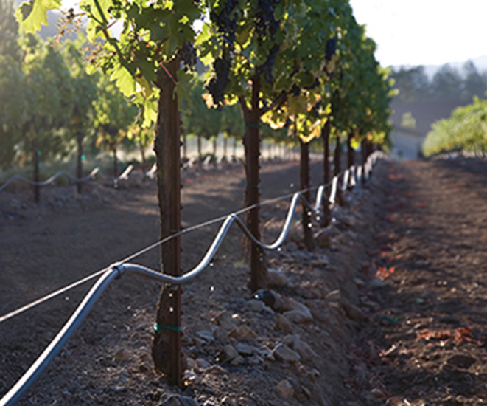
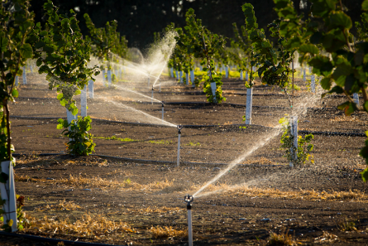
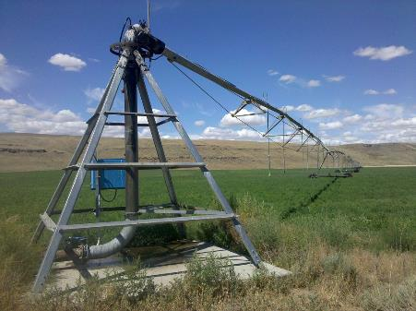
Efficient On-farm Irrigation
Drip, MicroSpray, Center Pivot
Excellent Uniformity
Excellent Control

Slide 8
Irrigation Efficiency Paradox
Efficiency Irrigation does mean less water is used.
  Less water used means less water used. Period.
Multiple studies have shown that improving irrigation efficiency alone does not equate to more water left in-stream, or in groundwater management areas.
  https://www.nature.com/articles/s43247-023-01152-2
  https://www.researchgate.net/publication/373832702_Evaluating_the_hydrologic_effects_of_the_2021-2022_Scott_and_Shasta_irrigation_curtailments_using_remote_sensing_and_streamflow_gages

Slide 9
Water Conservation
(Using Less water)
Less water diverted into irrigation ditch or Less water pumped from well
  Must be measured, not assumed.
More water remains for other uses (domestic, habitat, recreation, other irrigators) - Working towards Balance.
Not assumed based on efficiency of the on-farm system
Deficit Irrigation – Giving the crops less than ideal amounts of water. Some stress.
Crop type affects water use. Switching to more drought tolerant crops.
Irrigated Area is key factor. Fallowing land.

Slide 10
Optimization of Water
Most bang for your buck.
How much water do I need? Depends on Goals:
Keep grass green.
  Deficit irrigate to just keep crop alive
  50 to 75% irrigation amount
Maximize Yield?
  90 to 110% irrigation amount. Efficient and uniform irrigation.
Maximize Net Income?
  Maybe 80% irrigation amount? Varies.

Slide 11
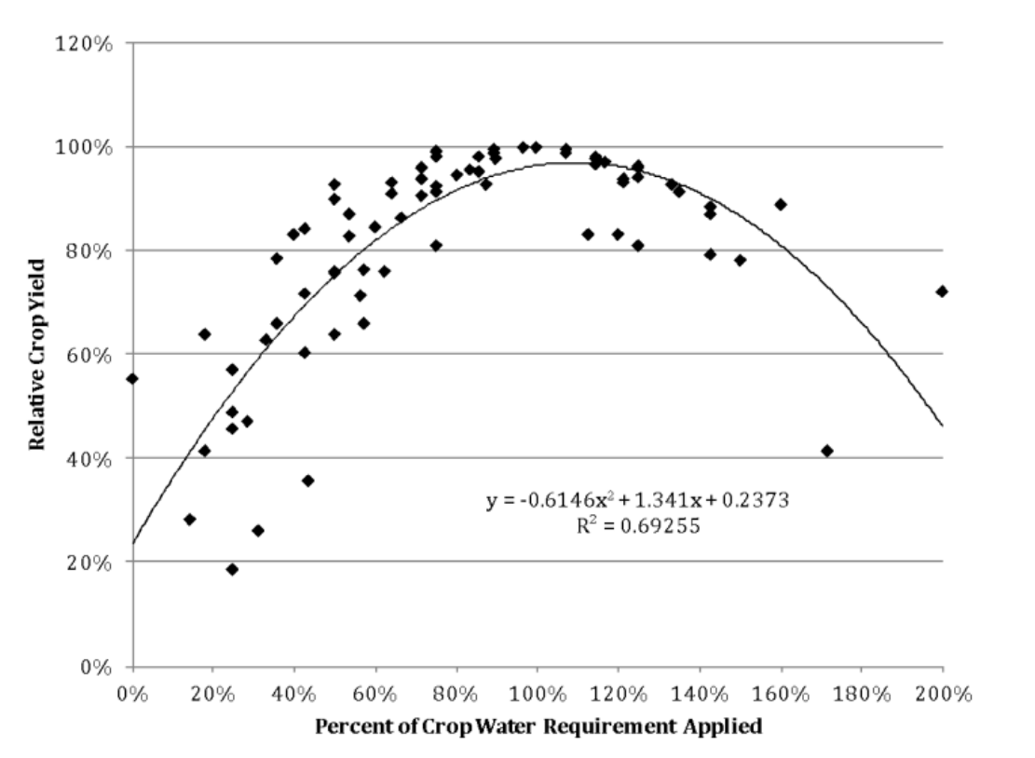
Optimization of Water
Max Crop Water Productivity
60% water applied = 80% yield
80% water applied = 90% yield
160% water applied = 80% yield.
Harmsen, 2018

Slide 12
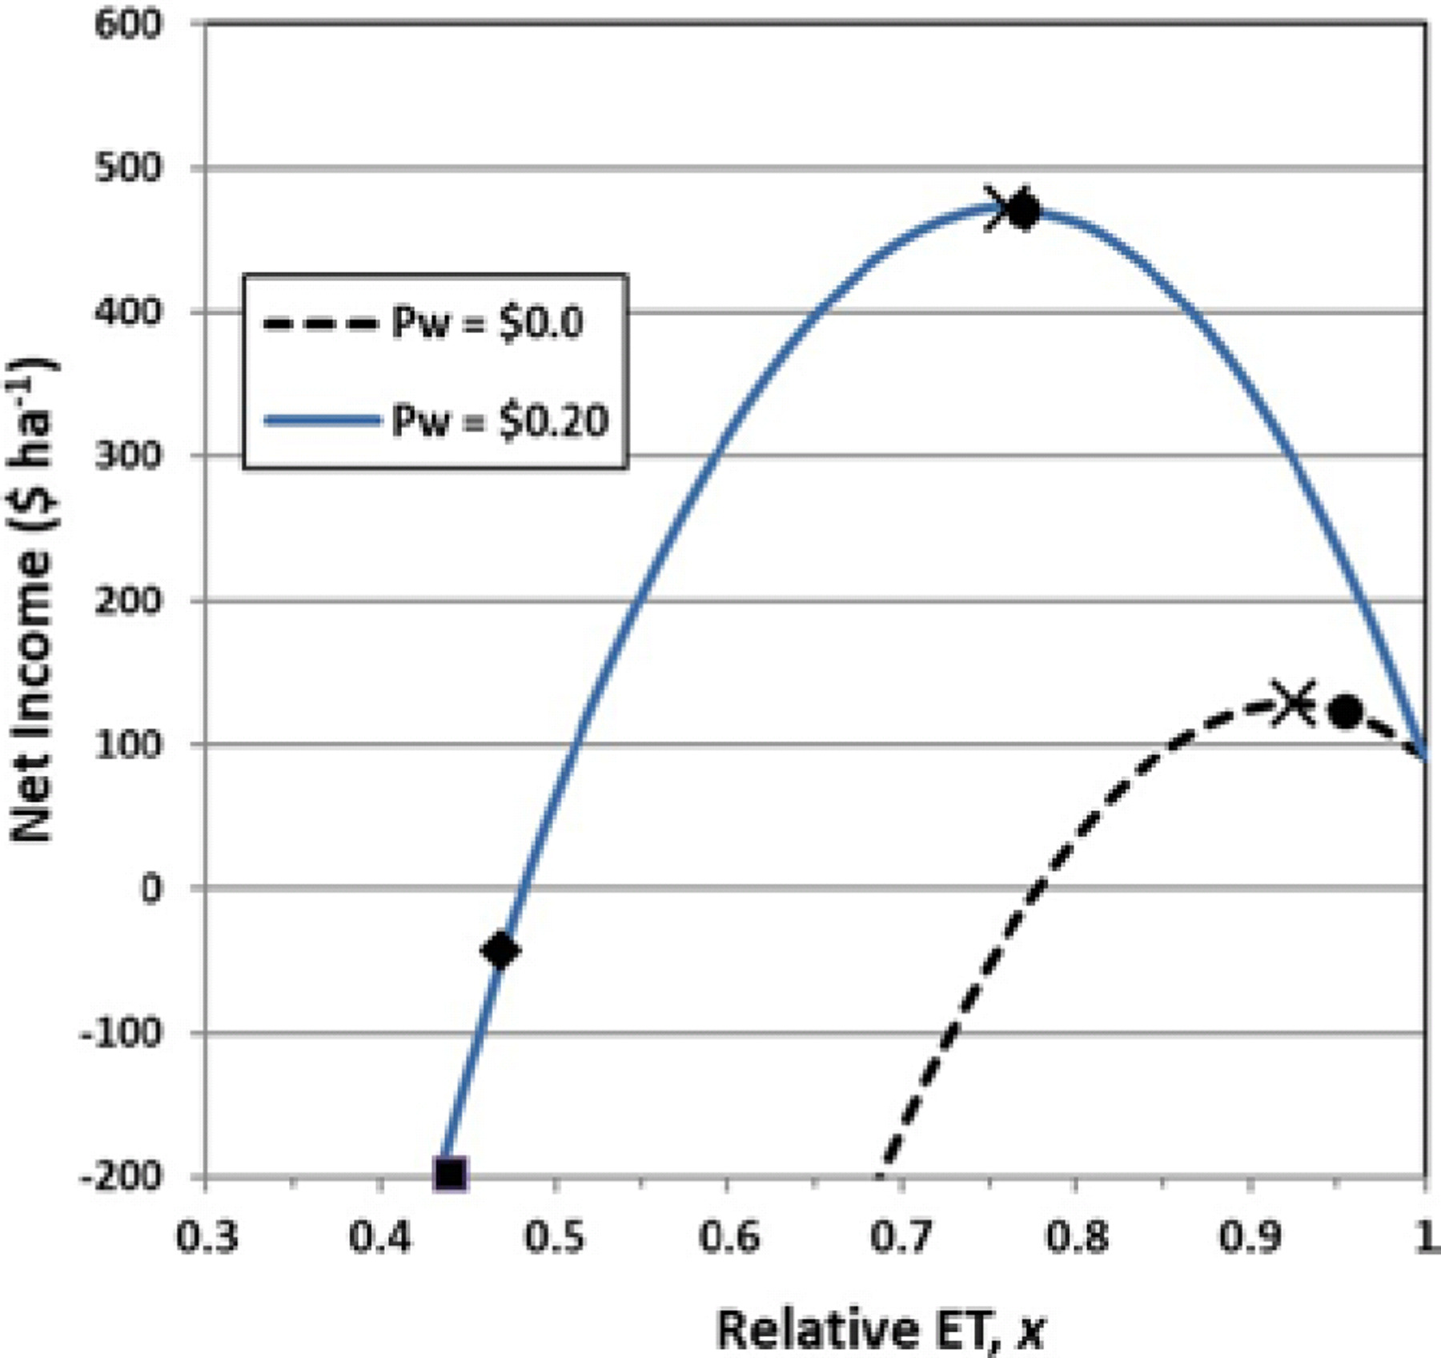
Optimization of Water
Max Net Income
Sweet spot of Water Applied to Net Income.
Increased water used by the crops does not equal the same increase in Net Income
ET = Evapotranspiration (Crop water Use)
Trout, Manning (2019). An Economic and Biophysical Model of Deficit Irrigation. Agronomy Journal….
‘Relative Crop Water Use’

Slide 13
How to Optimize Water Use?
Good Management – Reduce losses – be efficient
Grow Crops appropriate with Climate, Water Availability, and Soil Conditions
Store Water during Wet periods for use in Dry periods
  Soil water storage capacity – Organic Matter – Mulch
  Regenerative Practices
  Ponds / Tanks
Regulated Deficit Irrigation
Focus water on highest producing lands
Measure Crop Yields and Amount of Water Applied. Keep a Water Management Journal.

Slide 14
Optimize on Shared Systems?
Education and Training for Water Users
Governance Structure – Open Communication
Equitable Availability of Water
Shared Responsibility
Cost of Water
Water Measurement
Transparency

Slide 15
On-Farm Irrigation System
Call up your local irrigation contractor for options and costs!
Many different systems based on budget, crop type, terrain, soil, labor requirements, local contractor preference, and available parts and equipment.
Everyone wants a flexible system, that’s cheap to install, and doesn’t require much labor to operate.
Pump (not shared) with on-demand water availability, with buried PVC pipe to various risers allows for the most options in terms of crop production.
Flood irrigation is OK if managed well. Its very difficult to manage well.

Slide 16
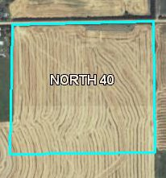

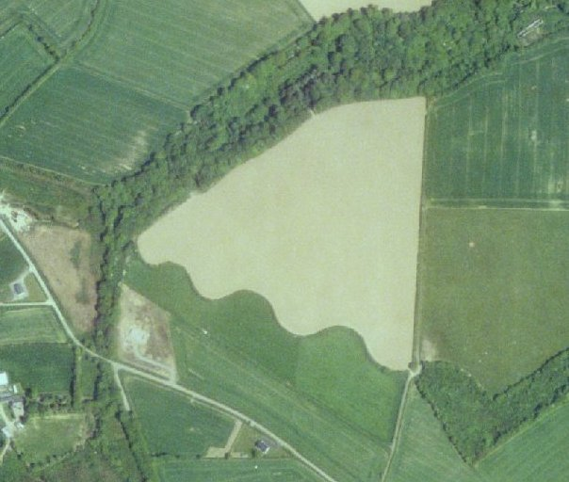

On-Farm Irrigation System
FIELD CHARACTERISTICS
Rectangular fields
Flat slope
Loamy soils
Many options – GO for it
Irregular Shaped Fields
Steep slopes
clay or sand soils
Fewer options - Pause

Slide 17
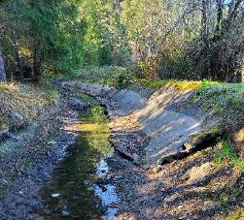
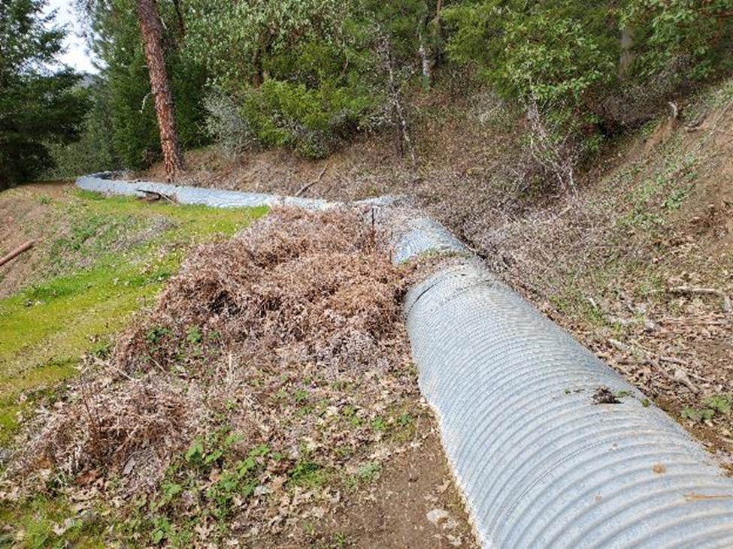
Distribution System
Shared Irrigation Ditches
Earthen Ditch
  Lots of Maintenance to stop rodents, remove vegetation, prevent blowouts.
Concrete and/or Rubber Liners
  Less maintenance, less chance for blowouts
Piped and Buried
  Longest lasting

Slide 18
Ag Water Quality
SWCD’s help implement voluntary management practices to prevent water pollution such as:
  Sediment and Erosion from Ag lands and farm roads
  Pesticides and nutrients from irrigation runoff
  Nutrients and bacteria from animal waste and manure
  Warmer stream temperature from warm irrigation runoff and inadequate streamside vegetation
Oregon Department of Agriculture
  OAR 603-090-000 through 0120
  Enforcement authority for the prevention and control of water pollution from agricultural activities.

Slide 19
Funding and Programs for Water Management and Efficiency
JSWCD
  Funds and Staff resources are focused on a National Water Quality Initiative near Eagle Point for the next 3 to 7 years.
  Trying to develop an Ag Water Quality Rebate Program. Small amount of funds to incentivize practices that reduce pollution to waterways from Agricultural practices in all areas of Jackson County.
NRCS has assistance for irrigation improvements and have many different funding pools with various requirements. Very popular option and widely used.
Other larger funding pools exist for Irrigation Improvements. OWRD, OWEB, BOR
  Projects must demonstrate Environmental, Social, and Economic Benefits.
  50% Match Required (typically)
  Helps to have a sponsor or partner agency, such as APWC

Slide 20
Questions and Discussion
Thank you for listening, any questions?
Resources:
  Working with NRCS
  ODA Ag Water Quality
  Natural Resource Stewardship Handbook
Feel free to reach out directly with any additional questions or concerns.
Paul DeMaggio. Paul.demaggio@jswcd.org
  541-630-0285

Slide 22
USACE Rogue River Basin Project Storage Amounts & Allocations
Credit: David Tucker,
US Army Corps of Engineers
Notes:
Primary Authorized Purposes (excepting Flood Risk Management) have specific maximum amounts allocated for release throughout the year.
Most years we have been able to fill and meet all of these amounts with the amount of water stored, which augments natural inflows to the reservoirs throughout the year.
Notable exceptions 2001 APP & LOS, 2014 & 2015 for APP.

Slide 23
Lost Creek & Applegate Refill 2015
Pools are now drafting in support of authorized purposes
Near average precipitation for the water year, near zero snowpack
  Lost Creek
    Total Storage Capacity 465,000 acre*ft
    1871.38’ / 0.62’ / 99% of useable capacity
  Applegate
    Total Storage Capacity ~ 70,000 acre*ft
    1955.78’ / 31.22’ / 63% of useable capacity
  Comparison of Total Storage Capacity
    *Howard Prairie – 62,100 acre*ft
    *Emigrant – 40,500 acre*ft
    *Reference: www.usbr.gov
Credit: David Tucker,
US Army Corps of Engineers
Notes:
Not all water in the reservoir is useable. At a certain point, only inflow will be passed to maintain a minimum amount of water for health of aquatic species in the reservoir. Everything above that level is useable storage.

Slide 24
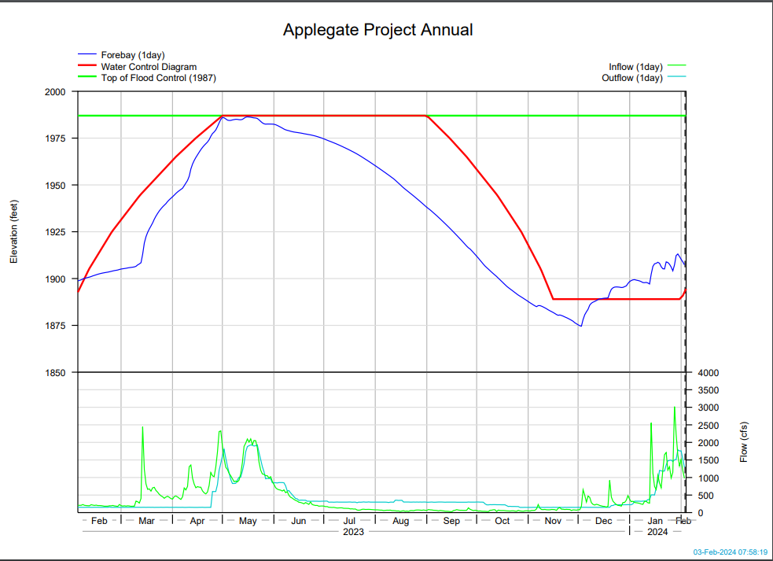

Slide 25
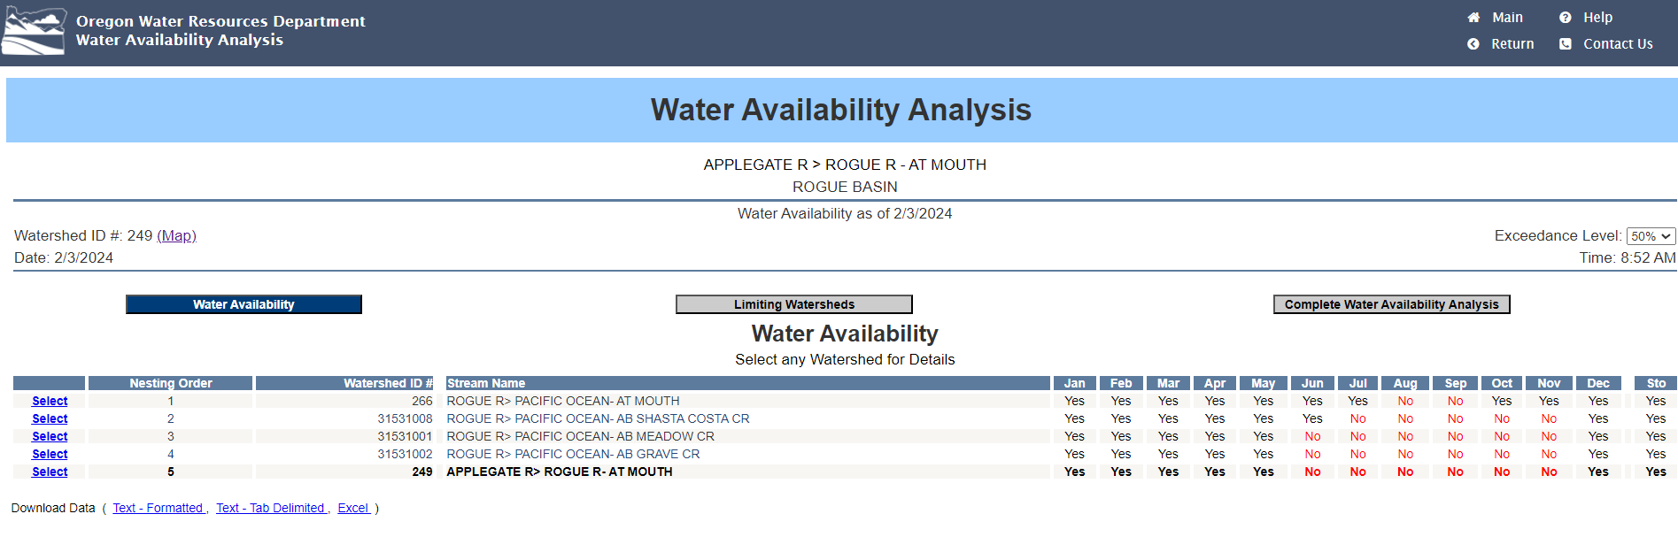

Slide 26
