Slide 1
Applegate Water Security Education Day
February 3rd, 2024

Slide 2
Agenda
Who We Are
Oregon Water Law
Exempt Uses
Instream Water Rights and Allocation of Conserved Water
Drought and Drought Tools
Water Project Grants & Loans

Slide 3
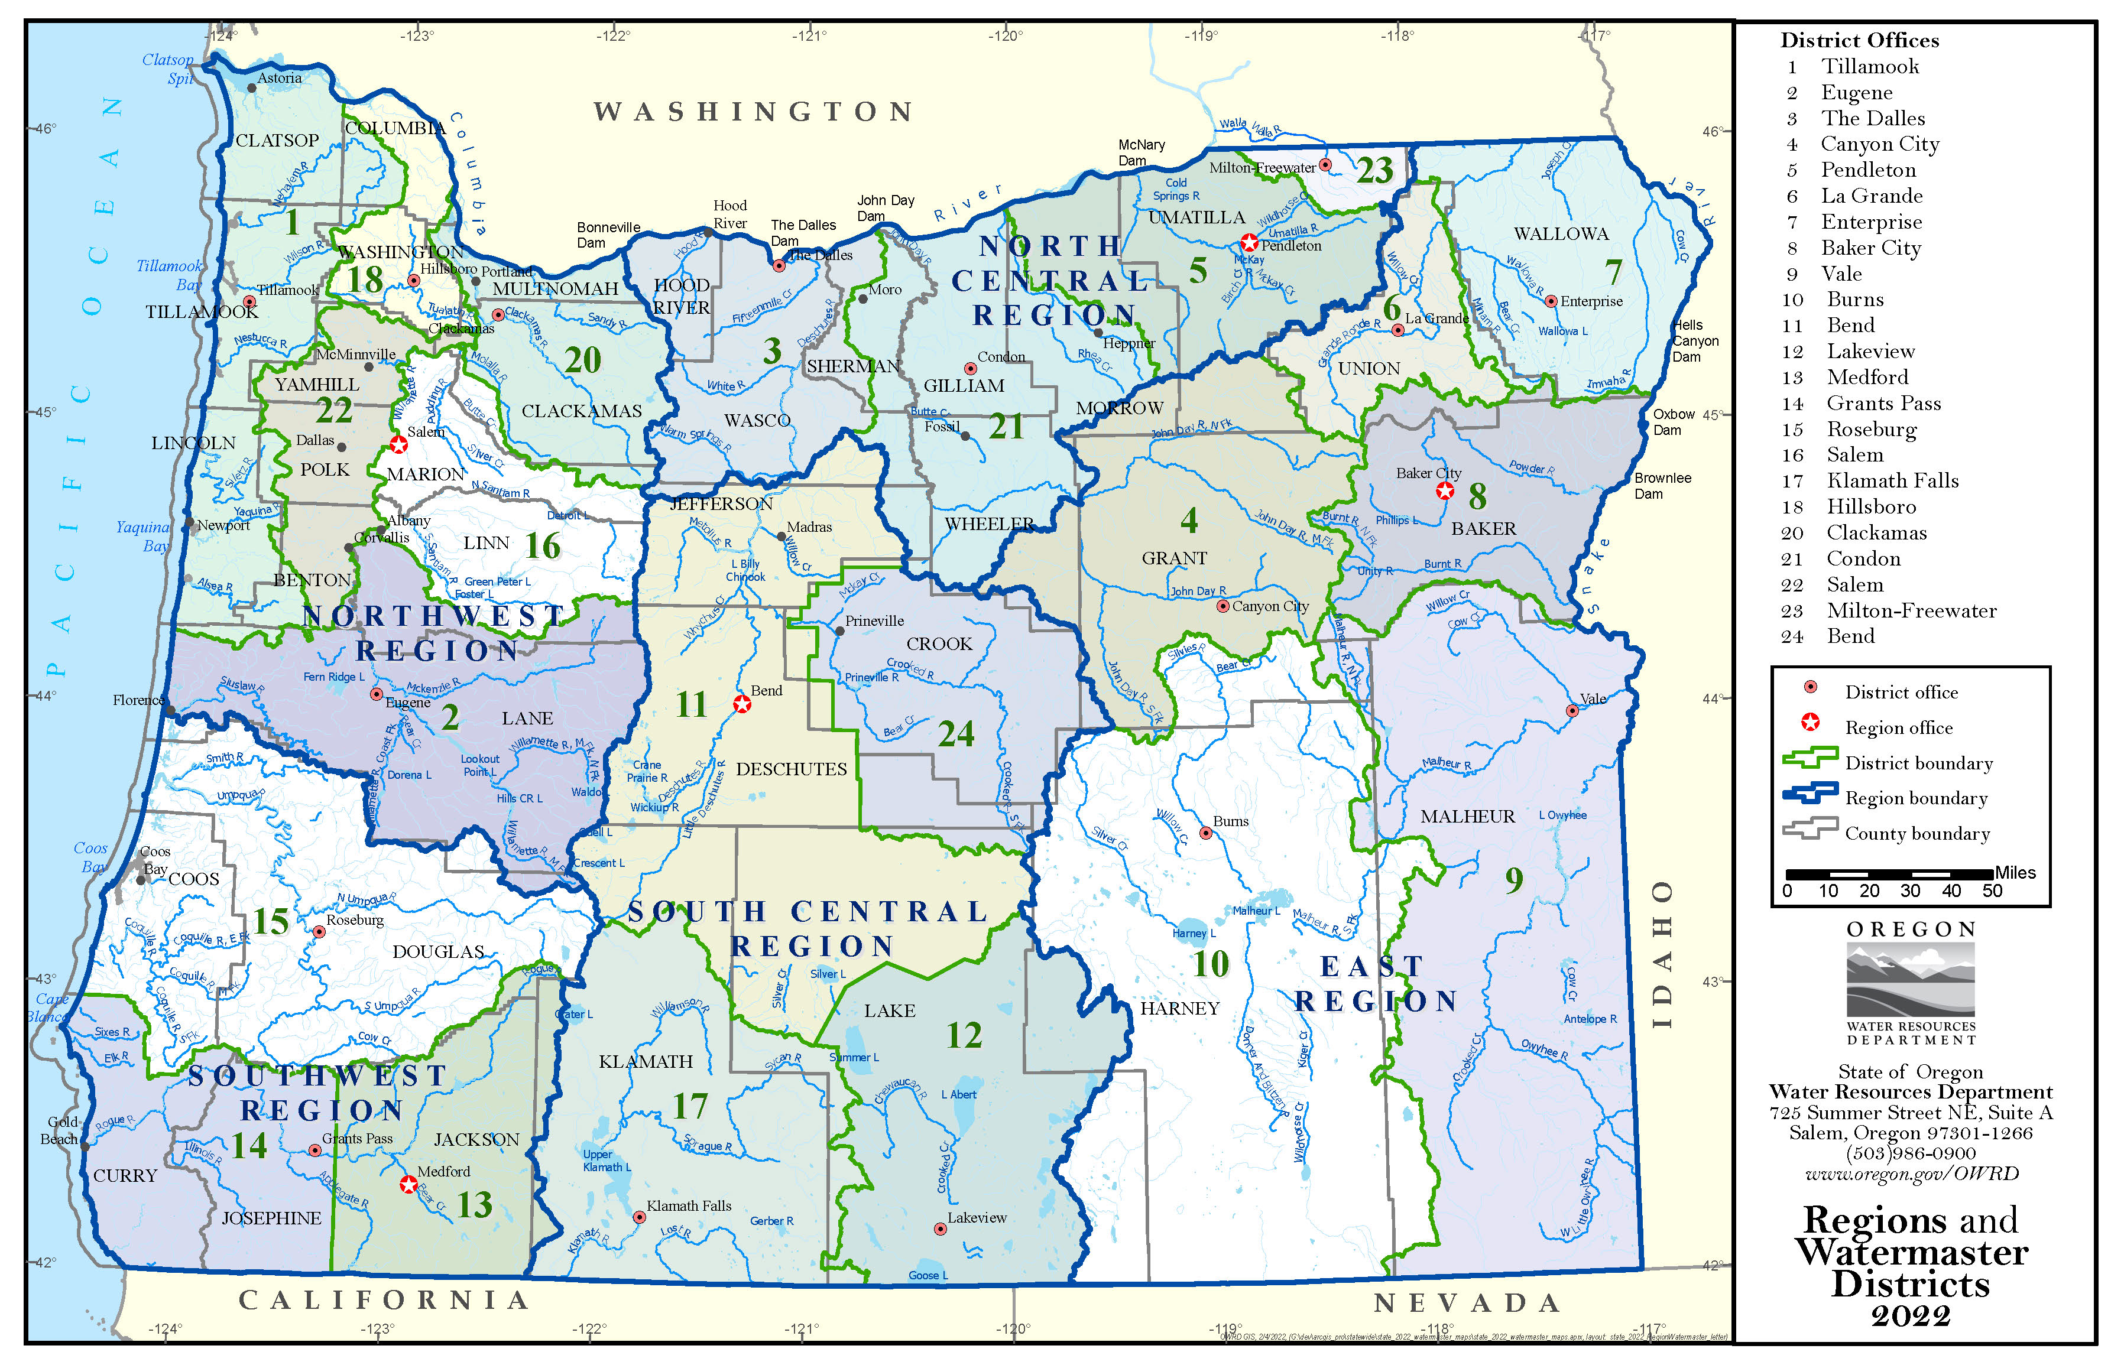
OWRD is a state agency
OWRD assures sufficient and sustainable water supplies are available to meet current and future needs in Oregon.
6 Regions
23 Watermaster Districts
The Southwest Region Office is at the County Courthouse, Room 309.
Notes:
OWRD was created in 1975 when the Office of the State Engineer and State Water Resources Board merged.
OWRD - state agency charged with administration of the laws governing the allocation of surface water and groundwater resources.
Vision
The vision of the Water Resources Department is to assure sufficient and sustainable water supplies are available to meet current and future needs.
Mission Statement
The Department's mission is to serve the public by practicing and promoting responsible water management through two key goals:
To directly address Oregon's water supply needs
To restore and protect streamflows and watersheds in order to ensure the long-term sustainability of Oregon's ecosystems, economy, and quality of life

Slide 4
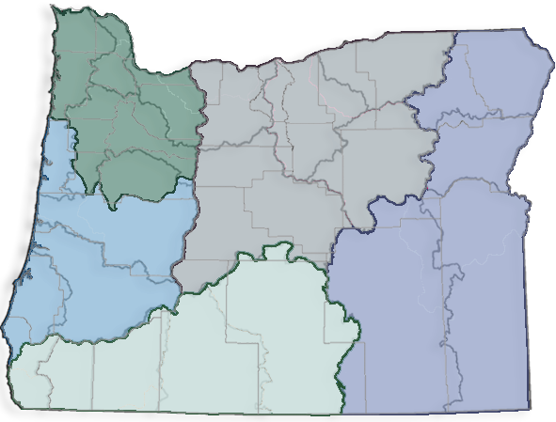
Commission and Department
Governor
Water Resources Department
Director
Water Resources Commission
Director’s Office
Northwest Region
North Central Region
Field Services
West Central Region
Water Right Services
Eastern Region
Southwest Region
Administrative Services
Westside-at-Large
Eastside-at-Large
Technical Services
Notes:
We are organized into 5 divisions; however, many of our divisions are highly connected and dependent on the actions of other divisions.
Water Resources Commission
Created in 1987
Policy Direction
Rule Adoption
Grant and Loan Approval
Seven-member citizen board, appointed by the Governor for four-year terms, subject to confirmation by the Oregon Senate.
two members at large, one covering east of cascades and the other covering west of the cascades.
Water Rights Services Division
Adjudications
Water right transactions
Hydroelectric licensing
Water management and Conservation Planning
Field Services Division
Water management and distribution
Well inspections
Data collection
Dam safety
Water measurement
Technical Services Division
Dam safety program
Surface water science
Groundwater science
Information services
Well construction
Compliance & Enforcement
Administrative Services Division
Fiscal services
Human Resources
Facilities
Support services
Director’s Office
Legislative, rulemaking, & policy coordination
Public records & information
Water Resources Commission
Integrated Water Resources Strategy
Community Engagement and Place-based planning support
Grant and Loan Programs
Executive and Commission support

Slide 5
How we achieve this
Water Rights Services
Water Rights Program
Field Services Division
Water Distribution
Technical Services Division
Information Management
Director’s Office
Oregon Water Commission
Planning Assistance
Community Engagement
Policy/ Legislative Coordination
Public Safety
Surface Water / Ground Water Investigations and Research
Well Construction & Inspection
Hydrographic Data Collection
Grants and Loans
Adjudication Program
Water Right Transfers/Leases
Customer Service Group
Hydroelectric Program
Conservation Program
Watermaster Services

Slide 6
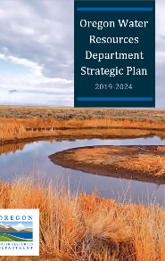
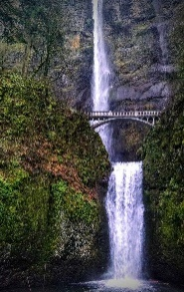
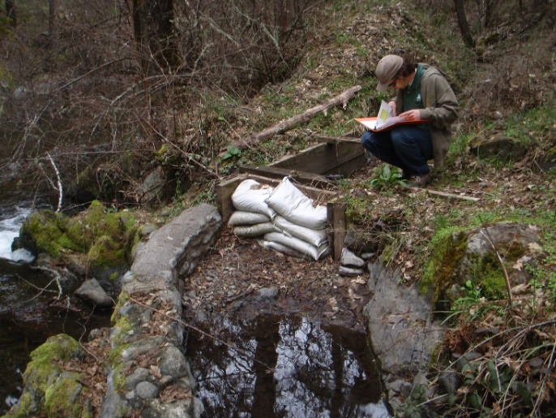
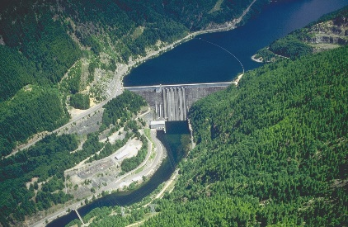
Waters of the State
Surface Water and Groundwater
Must obtain a water right to use public water from any source except under ORS 537.545 and ORS 537.141 and few other exceptions.
Notes:
The Water Code declared all water within Oregon as belonging to the public and required that anyone who wanted to use surface water had to first obtain a water right from the state.
Including both surface and groundwater
We have a Strategic Plan that is informed by IWRS
Dam Safety

Slide 7
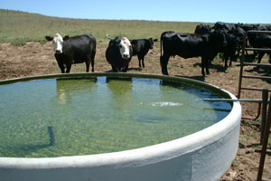
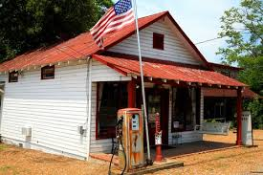
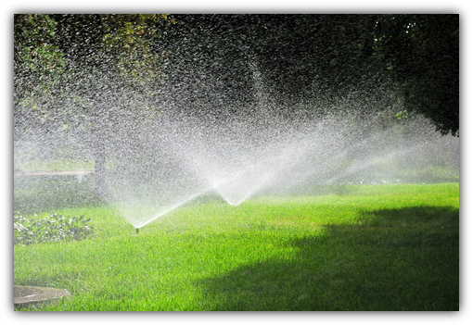
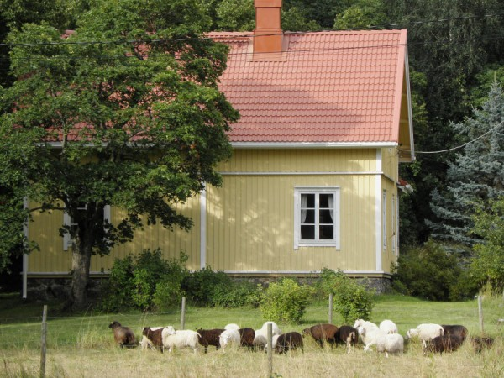
Exempt uses of ground water...
ORS 537.545
Domestic Wells
15,000 gallons /day
Single industrial or commercial use
5,000 gallons /day
Non-commercial Lawn and Garden
Up to ½ acre
Stock watering
Emergency fire-
fighting uses
...do not require a water right
Notes:
Note that there are Well Water Handbooks
There is no volume identified for the half acre of lawn and non commercial garden. The key! Water has to be used beneficially and without waste.
To clarify, up to a half acre of non commercial lawn and garden. The 5,000 gallon commercial industrial use is NOT to be used for the promotion of plant growth.
Industrial Examples: operation and maintenance of industrial sites, road construction, down-hole heat exchange and geothermal
Commercial Examples: production, sale or delivery of goods, services or commodities by a public or private entity – Commercial facilities include office, resort, recreational facility, motel, hotel, gas station, store.

Slide 8
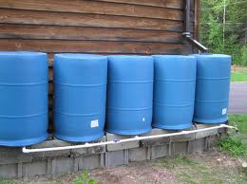
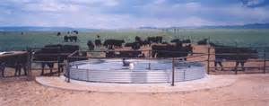
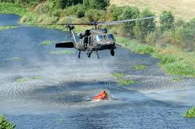
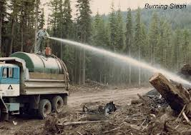
Exempt uses of surface water...
ORS 537.141
Livestock watering
Emergency fire-
fighting uses
Some forest management practices
Land management practices
Fish protection
Rainwater catchment
...do not require a water right
Notes:
Forest management: certain activities such as slash burning and mixing pesticides. To be eligible, a user must notify the Oregon Water Resources Department and the Oregon Department of Fish and Wildlife and must comply with any restrictions relating to the source of water that may be used.
Land management practices intended to save soil and improve water quality by temporarily impeding or changing the natural flow of diffuse water across agricultural lands when storage of public waters is not an intended purpose. Examples: terraces; Dikes, rough tillage, agronomic practices which control surface runoff to prevent erosion.
Fish protection: egg incubation projects under the Salmon and Trout Enhancement Program (STEP) are exempt. Water used for fish screens, fishways, and bypass structures are also exempt.
Rainwater must be off an artificial impervious surface – Jackson Soil and Water Conservation District, who presented earlier today, have a Rainwater Catchment Program if you’re interested.

Slide 9
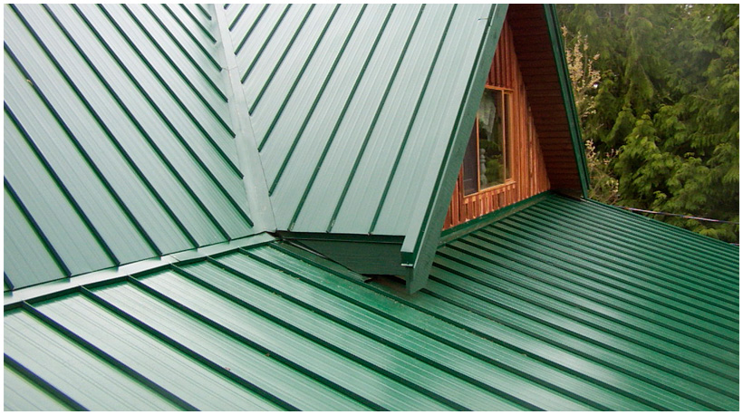
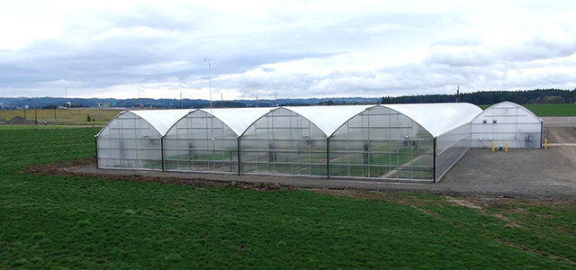
Rainfall Catchment
USGS Rainfall Calculator:
“USGS Rainfall Data”
Estimate your annual water needs
Calculate your impermeable surface space
12 inches of rain
60 ft x 60 ft = 26,929 gallons
Notes:
USGS rainfall capture calculator
NOAA average rainfall totals

Slide 10
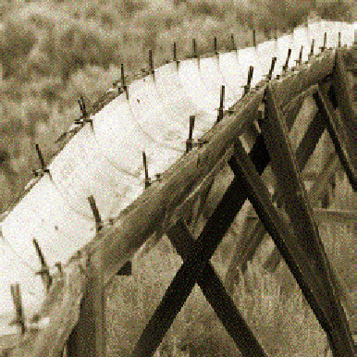
The 1909 Water Code
1) Priority
first in time, first in right
2) Appurtenance
attached to the land
3) Must be used
at least once every five years
4) Beneficial use without waste
water for personal or public good
codifying the doctrine of
prior appropriation
Notes:
ORS 537.110
Page 5 of water rights book
In Oregon, the prior appropriation doctrine was adopted into statute on February 24, 1909 and introduced state control over the right to use water. Before then, water users had to depend on themselves or local courts to defend their rights to water.

Slide 11
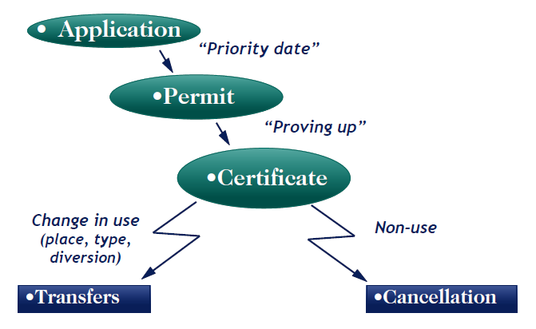
The Permit System
three step process
Notes:
Priority Date – Doctrine of Prior Appropriation
Submit application
Public notice
Public comment period
OWRD review
Preliminary determination
60 day protest period
Approval order – Permit issued
Permit amendment
5 years to complete COBU – needs to be completed by a Certified Water Rights Examiner
Department issues certificate

Slide 12
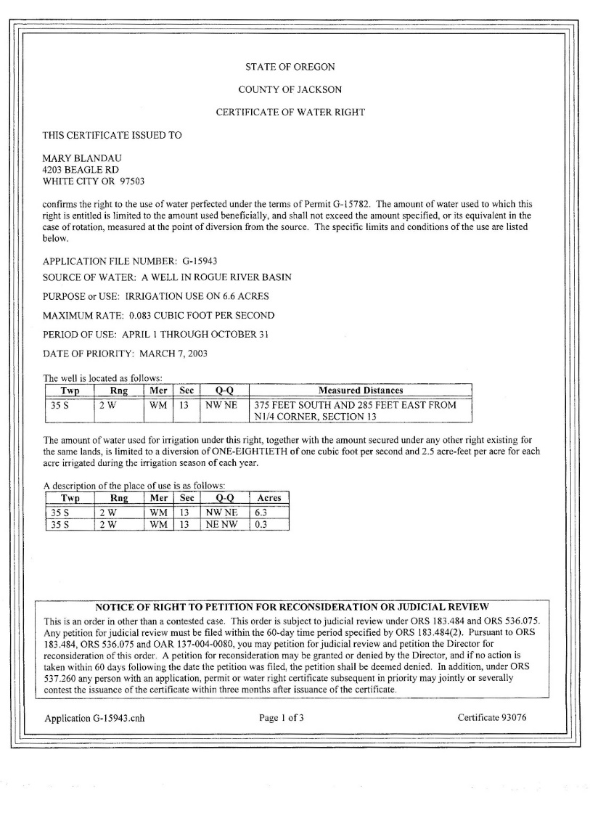
Water Rights: The Basics
Type of use
Source of water
SW or GW
Season of use
Priority date
Point of diversion or Appropriation
(POD or POA)
Appurtenant
(water right is tied to
the land, not the owner)
Notes:
Note that there are AquaBooks available at our table....
Emphasize that water rights are complicated and there are two-hour presentations on them? We can provide that at another time if there is interest....

Slide 13
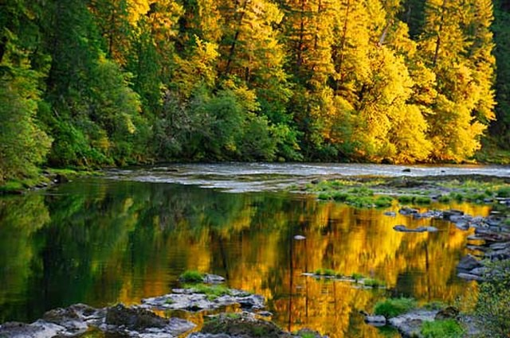
Managing your water rights
Must be used at least once every five years.
Water must be put to Beneficial
Use – irrigation, recreation,
habitat, etc.
Efficient use of water, without waste,
consistent with laws, rules, and best
interests of the people of Oregon.
Options for water right holders?
Opportunities for new water rights?
Notes:
Beneficial use can be identified by basin as well

Slide 14
Instream Water Right Act
Adopted in 1987. Established the Instream Lease Program and Instream Transfer Program.
Instream lease
Voluntary means to aid the restoration and protection of stream flows
Lease for up to 5 years – reverts to original right
Protects the water right and creates instream benefit.
Time-limited instream transfer
Similar to an instream lease but for any length of time.
Instream transfer
Permanent flow restoration and results in the issuance of an instream water right certificate, which is held in trust by the Department.
Notes:
Instream lease is considered beneficial use and can be renewed.
Additionally, Instream Water Right Act established tools for certain state agencies to create instream water rights and convert existing minimum perennial stream flows to instream water rights.
The Department of Fish and Wildlife, Parks and Recreation Department, and Department of Environmental Quality can submit applications to protect water instream.
More than 900 instream rights have been established through this process, and are held in trust on behalf of the public by the Water Resources Department.

Slide 15
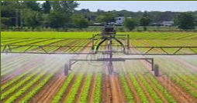
Allocation of Conserved Water
Voluntary program – promotes efficient water use.
Provides agricultural and community benefits while protecting instream values.
Save water through conservation – use a portion on additional lands.
Water Resources Commission allocates 25 percent of the conserved water to the state (for an instream water right) and 75 percent to the applicant.
Notes:
OAR 690-018-0020(3) "Conservation" means the reduction of the amount of water diverted to satisfy an existing beneficial use achieved either by improving the technology or method for diverting, transporting, applying or recovering the water or by implementing other approved conservation measures.
Conservation measure – physical change that allows you to satisfy an existing beneficial use with less water.
Switch from flood irrigation to drip lines.

Slide 16
Reservoirs
Standard: Store greater than 9.2 acre feet of water & have a dam height greater than 10 feet (more than 1 reservoir) Store 9.2 acre feet or more of water & have a dam height of 10 feet or greater.
Alternate: Store less than 9.2 acre feet of water or have a dam height less than 10 feet (1 app per reservoir).
Exempt Ponds are ponds that
do not need a water right:
Bulge Pond
Not designed for year-round storage
Filled by impervious surface runoff
Notes:
Options: Lost Creek and Applegate Reservoir
Touch on application process
As less water is available OWRD is steering people toward standard reservoir process – alternate one doesn’t have avenues for mitigation, and we’re needing mitigation measures more and more to reduce harm. And other agencies requiring it, so we can initiate Alternate Process with you and you’d have to switch mid-stream…..
Bulge – Legally diverted water, temporary storage

Slide 17
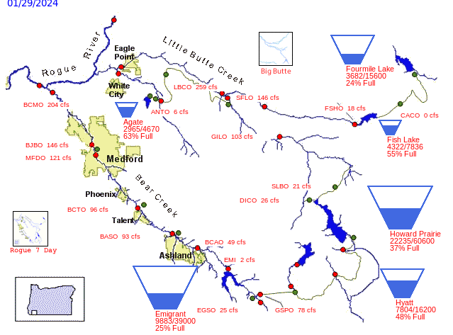
BASIN STORAGE
Rogue Basin BOR Reservoirs
Notes:
98% of the SWR’s irrigation occurs from surface water often from storage.

Slide 18
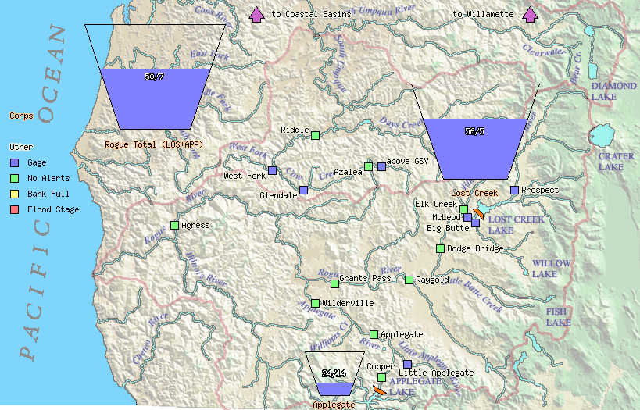
BASIN STORAGE
Rogue Basin USACE Reservoirs
Notes:
Applegate Receives stored water from Applegate Reservoir.
- Mention BOR fill curves.
Requires permit and contract with BOR
Same for Lost Creek Reservoir.

Slide 19
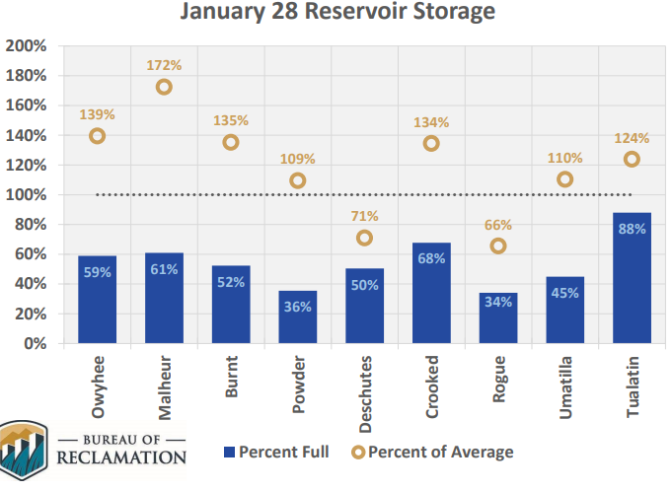
Reservoir Storage
Notes:
- Starting off better then last year but, storage and snowpack are of concern.
- Our reservoirs are primarily fed by spring snow melt. Our warm weather has resulted in limited snow building.
Reservoir storage in many basins is currently above average. However, projects in the Deschutes and Rogue basins are measuring below average.

Slide 20
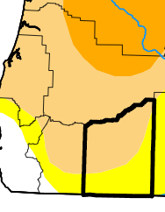
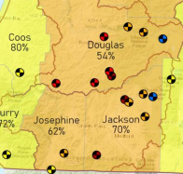
Drought Declarations
13 Oregon Counties received Drought Declaration for 2023.
17% of Oregon is experiencing moderate (D1) to severe (D2) drought conditions. Conditions across Oregon have shown improvement the past few weeks.
Stream flow well below normal in November.
Recent rains have improved flows since this reporting period.
Notes:
Oregon Drought Declaration Process – Counties declare a drought at the local level and and submit the declaration to the Drought Readiness Council and Office of Emergency Management.
- The Council Reviews and makes recommendations to the governor. If approved the governor through Executive Order authorized a Governor Declared Drought Declaration.
Drought Declarations open up tools for OWRD
- Emergency Drought Use Permits, Transfers, Reduced Fees, and Expedited Processing.
More serious conditions may require further action, including a declaration of emergency as defined under ORS 401. When requesting a declaration of emergency by the Governor, local governments must first conduct response operations to the full extent of their capability, as defined by local statutes and more fully described in emergency operations plans. A
Federal Declaration Process Several federal assistance programs become available when a federal drought designation is issued. Federal drought designations are automated using the U.S. Drought Monitor and are administered d differently than drought declarations issued by the Oregon Governor.
- An Oregon county receives a federal drought designation when any portion of the county meets the “severe” drought intensity value for eight consecutive weeks or has any portion in extreme drought.

Slide 21
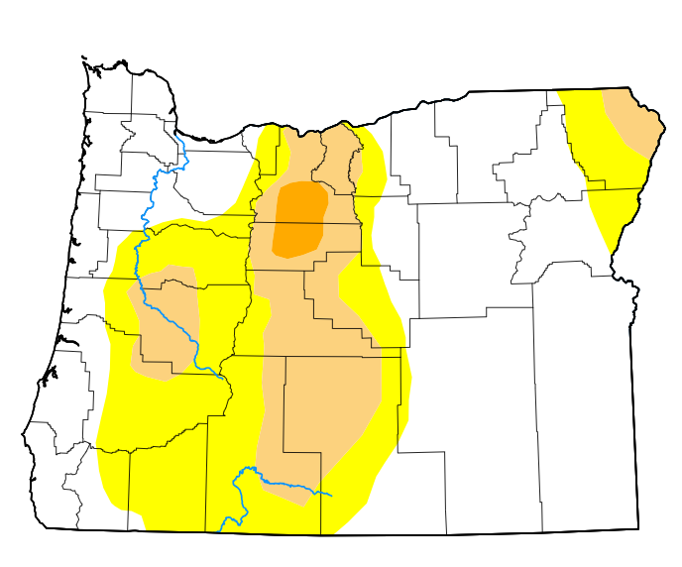
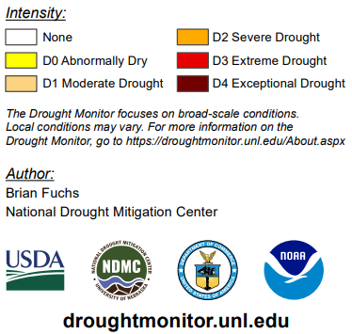
Overall Drought
January 23, 2024, roughly 44% of Oregon was abnormally dry (D0) with 18% experiencing moderate drought conditions (D1). Conditions across Oregon have shown improvement.
Near Term Outlook is leaning towards near to above average precipitation, below normal temperatures.
Notes:
Drought Declarations open up tools for OWRD
- Emergency Drought Use Permits, Transfers, Reduced Fees, and Expedited Processing

Slide 22
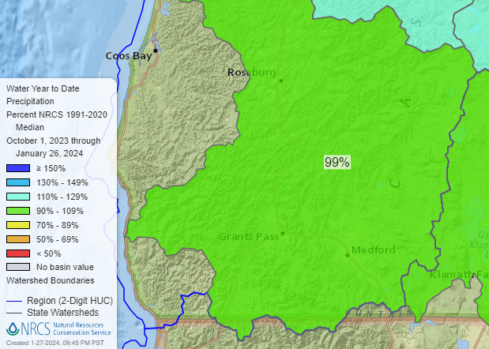
Precipitation
Water year to date – 99% of median for Rogue-Umpqua basin

Slide 23
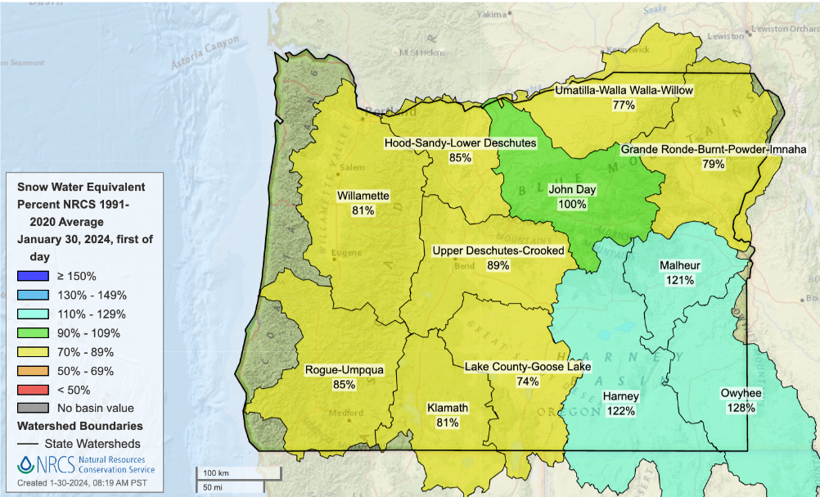
Snowpack
Snow water equivalent – 85% of median for Rogue-Umpqua basin
Notes:
Snowpack is one of the most important resources in the Northwest, both economically and ecologically. In the West, mountains act as natural reservoirs by collecting snow in the winter and releasing it in the spring as temperatures increase. Between 60 and 70% of water supplies come from snowmelt. Snow Water Equivalent is the measure of the amount of water available in snow.
Overall were in decline from a stormy January which was an anomaly for El Nino years. "And that’s in part - or mostly due to warmer temperatures and much of the precipitation that fell in the past few days, even up at high elevation, has fallen as rain.
This is proving challenging for reservoir managers as they are used to seeing snow in the higher elevations as opposed to rain and in some cases have had to release water. This prove challenging for spring irrigators.

Slide 24
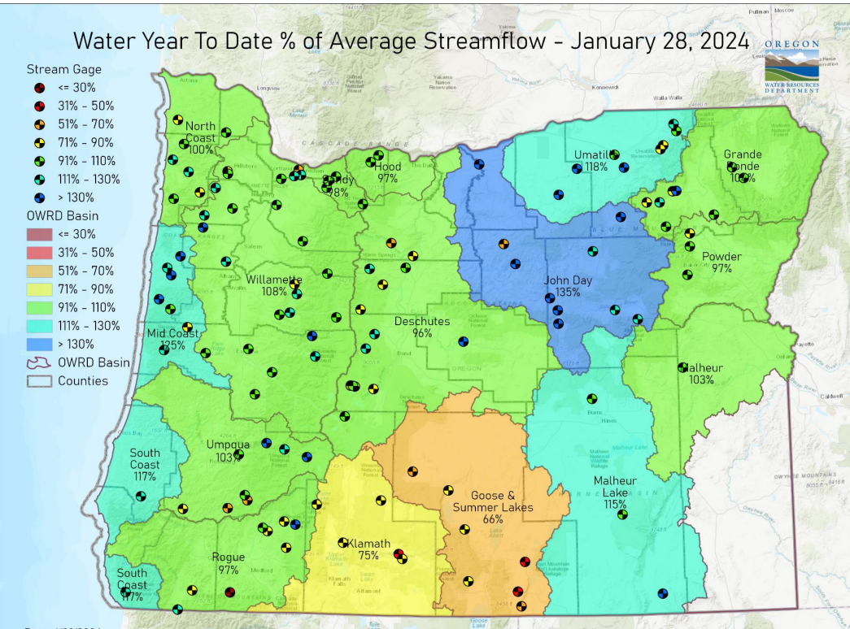
Water Year to Date- Streamflow's
Higher Flows North, Central, and East.
Lower South Central and Southwest.
Notes:
There has been some melting with the warming temperatures and liquid precipitation events.
- In the South Central and the Southwest Regions streamflow's range from 31% of normal inland to over 100% on the immediate coastal streams.

Slide 25
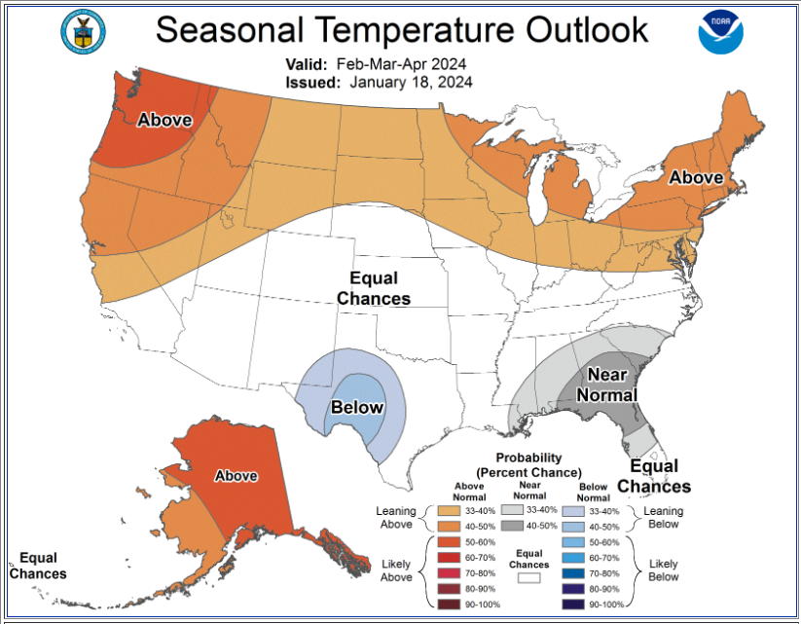
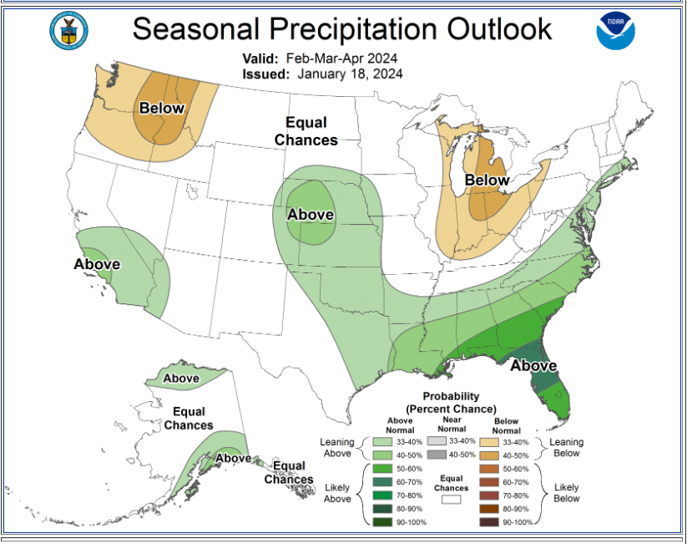
LOOKING AHEAD
Three Month Seasonal Outlook.
Conditions favor above average temperatures and equal chance above/ below precipitation. (98% of the SW Region Irrigation is Surface Water) Snowpack Dependent

Slide 26
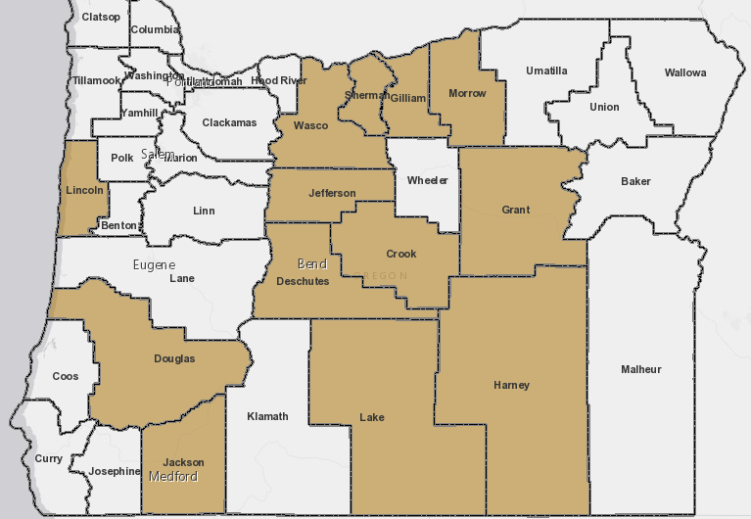
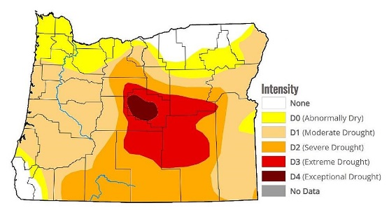
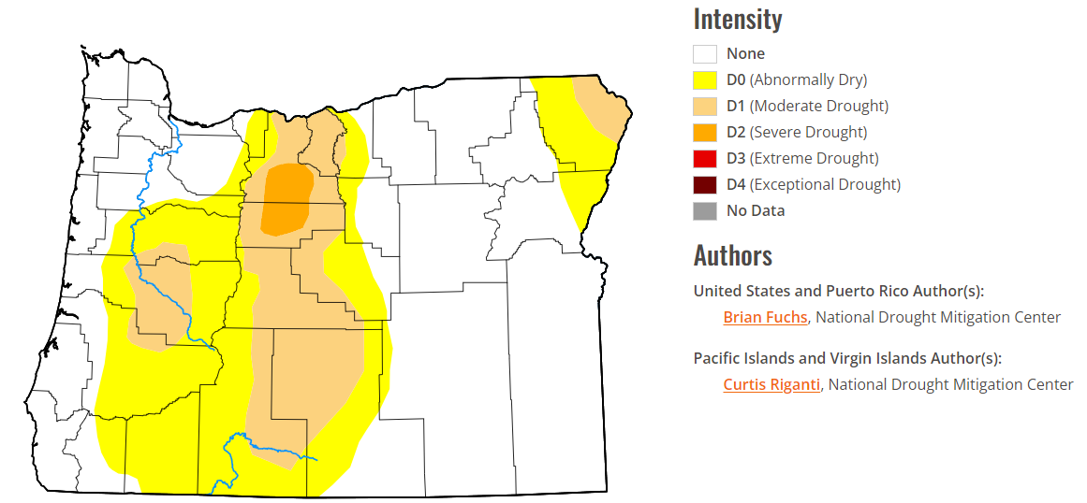
Drought Tools
Jackson County was given Drought Declaration Status by Oregon’s Governor for 2023.
OWRD’s Drought Declaration Status Map (state.or.us)
Benefit: Allows OWRD to provide water right holders with a number of water management tools to which they would not otherwise have access.
www.oregon.gov/owrd/programs/climate/droughtwatch/Documents/State_Drought_Process_and_Tools_Final.pdf
Commonly used tools:
temporary drought emergency water use permits.
temporary drought transfers.
2023
2023
Current
Notes:
Emergency Drought Tools
expedited review process
reduced fee schedule
Intended to be short-term emergency authorizations, not permanent solutions to deal with water supply challenges.
Temporary emergency water use permit
Use of groundwater to make up a deficiency in the primary
Temporary Transfer
Change in type of use, place of use, diversion location
Temporary substitution
Allows for use of a supplemental groundwater right in lieu of primary surface water right
Human Consumption or stock water use preference
Water Resources Commission can grant preference to human consumption and stock water over senior call, requires approval of temporary rules.

Slide 27
Water Project Grants & Loans
Purpose: Support the development of water resource projects such as increased water storage, reuse, conservation, conveyance, etc.
Applications now accepted twice a year. Last application deadline was in January.
Funding Decision: May 2024
(Anticipated second 2024 application cycle; decision in Nov/Dec 2024)
"Triple Benefit"
Environmental
Economic
Social/ Cultural
For more information: waterprojects@oregon.gov​​​
Notes:
Feasibility Grant Page: Water Resources Department : Feasibility Study Grants : Feasibility Study Grants : State of Oregon
Triple Benefits (Scoring criteria): Scoring Criteria (oregon.gov) (need at least one in each category, not each criteria)
Mention Observation Wells and Water Measurement Cost Share Programs
Funding specifics
Loans, Grants (25% cost-share)
Loan Specifics – Term, Interest Rates
Funding Decision 1/year
Scoring and Ranking of Projects
Technical Review Team
Scoring based on Economic, Environmental and Social/Cultural Public Benefits
Final Decision made by Water Resources Commission

Slide 28
Feasibility Study Grants
Conservation
Reuse
Storage
Purpose: Provide match funding for project planning studies performed to evaluate the feasibility of a water conservation, reuse, or storage project
Deadline: Fall each year
Funding Decision: Spring each year
For more information: fsgrants@oregon.gov​​​
Notes:
Purpose
What is a feasibility study? Limitations
Project Examples
Small scale AR
Piping/Lining – Conservation
Expansion of Storage Facilities

Slide 29
Other Resources
Water Measurement Cost Share: Pays a portion of the cost to install, repair or replace water measurement devices for water right related diversions or pumping.
WARRF: Funding to help Oregonians repair or replace and permanently abandon household wells that were impacted by drought or wildfire.
Currently out of funds. Keep checking back!
Will be providing support for some contaminated wells soon.
Notes:
Work with your Watermaster for Water Measurement Cost Share Program
WARRF link:

Slide 30
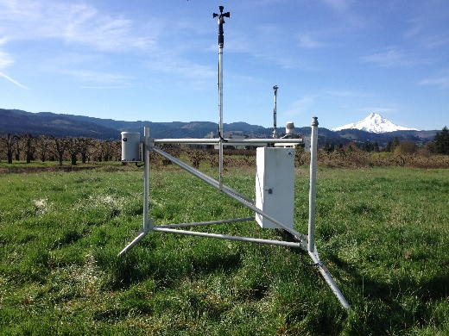
Ways to Participate in Water Management and Research!
Observation Wells:
Measures the static level in wells across Oregon.
This is one data point to understand our groundwater levels – changes, patterns, etc.
Landowners around the state participate!
Agri-Met Stations:
Collects air temperature and humidity, solar
radiation, wind speed and direction, total precipitation,
and soil moisture and temperature.
Useful for irrigation scheduling and crop management.
Expanding network – new stations coming in Ashland, Eagle Point, Grants Pass, Cave Junction, Provolt and Winston!
Join OWRD’s Regional Email list :
Sign up at OWRD’s table!
Notes:
Full link to Obs Well map – GWIS Map Tool (state.or.us)
Put talking points about ideal site for station –
1) at least 1 acre
2) irrigated and/or mowed/maintaned turf or pasture
3) no vertical obstructions that could block solar radiation or wind
4) solar radiation most important factor to not block

Slide 31
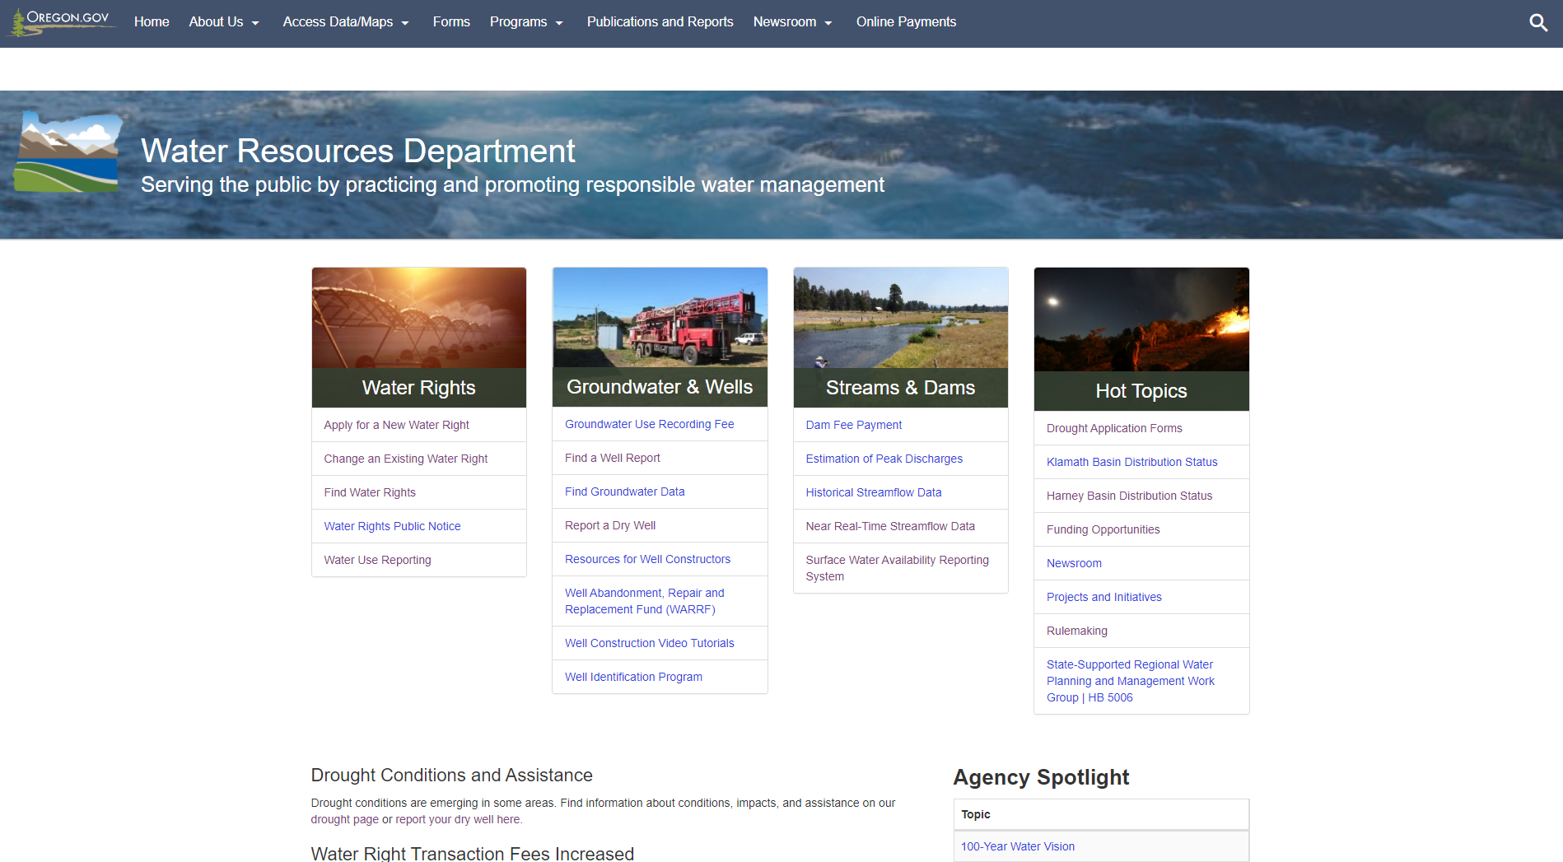

Slide 32
Feel free to contact us!
Justin Dillon – Southwest Region Manager:
For concerns affecting the whole region, or the department as a whole.
Scott Ceciliani - District 14 Watermaster (Josephine and Curry Counties)
For technical assistance re: water laws and regulations and your property’s water needs
Sue Parrish – Region Community Engagement Coordinator:
For opportunities to address needs or connect to resources for your community.
Find My Watermaster Link:
For general information regarding OWRD services, and to find local technical assistance resources.
Our business cards are at our table display!
Notes:
Mention Resource Summary at table and can sign up for communications from OWRD

Slide 33
Thanks for joining today!
Notes:
Sue – And this one : )...

