Slide 1
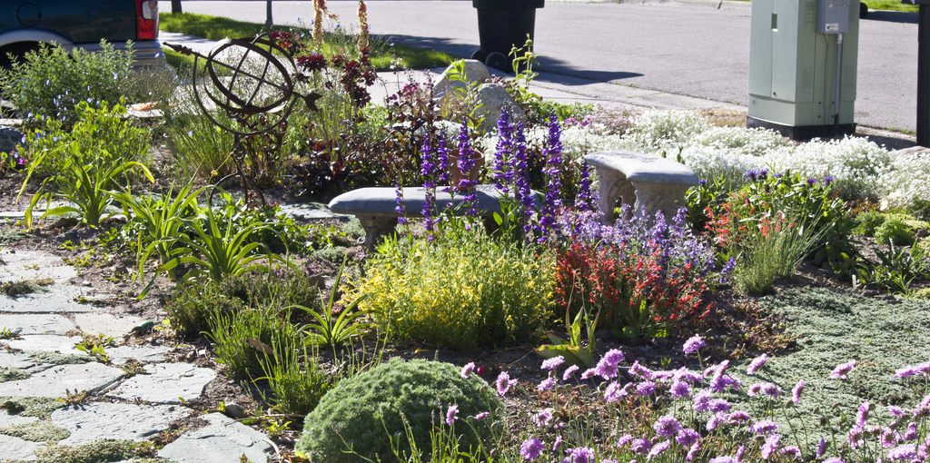
Household & Residential Landscape Water Conservation
Applegate Water Security Day
February 3, 2024
Kora Mousseaux
Community Water Resource Conservationist
Jackson Soil & Water Conservation District

Slide 2
Outline
JSWCD Overview
Water Conservation Needs
Indoor Water Conservation
Outdoor Water Conservation
Water-Wise Landscaping
Resources Overview
Q & A
Notes:
45 min presentation time (11-11:45) ; 15 minutes Q & A 11:45-12:00

Slide 3
JSWCD OVERVIEW

Slide 4
Who We Are
Special District in Jackson County
Serving residents and land managers to help with natural resource concerns
SWCDs originated from the Dustbowl Era (1930’s)
Jackson SWCD Established in 1966
Tax rate passed in 2006
Slogan:
“Turning Natural Resource Concerns into Opportunities.”

Slide 5
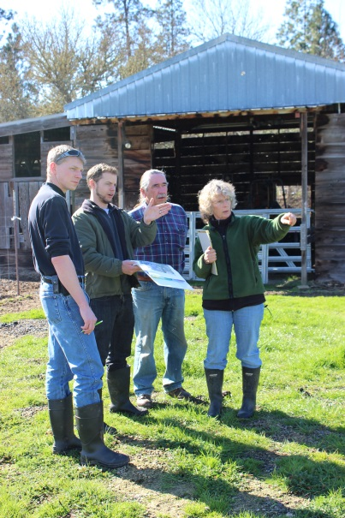
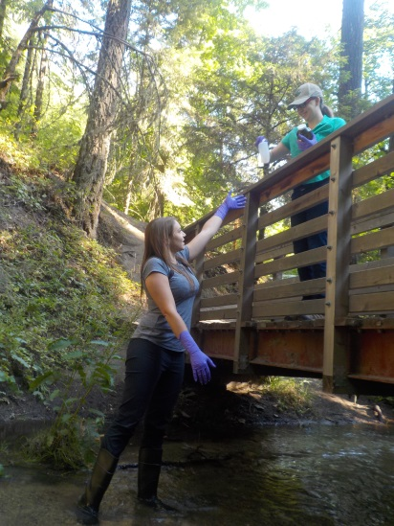
What We Do
Driving force: provide free technical assistance to Jackson County Residents regarding their natural resource concerns
Ways to get there
Project Planning
Funding
District Funds (very competitive)
External Funding
Education/Outreach
Workshops/presentations
Tabling events
Water quality monitoring programs

Slide 6
JSWCD Resource Priorities and Programs
Ag Water Quality
Aquatic Habitat Quality
Climate Change
Domestic Water Quality
Novel Invasive Species
Riparian Habitat Function & Condition
Rural/Urban Interface
Soil Function & Condition
Soil Loss
Storm Water Quality
Upland Habitat Function & Condition
Water Conservation

Slide 7
WATER CONSERVATION NEEDS

Slide 8
Why Should We Conserve Water?
Notes:
Why conserve water?
Where does our water come from?

Slide 9
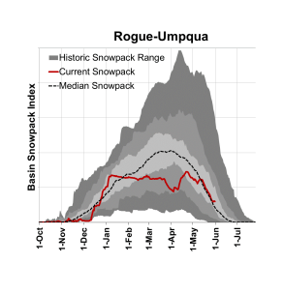
Our Water Falls as Snow!
The Climate is Changing
We depend on snowpack for city water
Inconsistent Snowpack leads to inconsistent water sources
Reducing water usage helps with capacity and changing climate

Slide 10
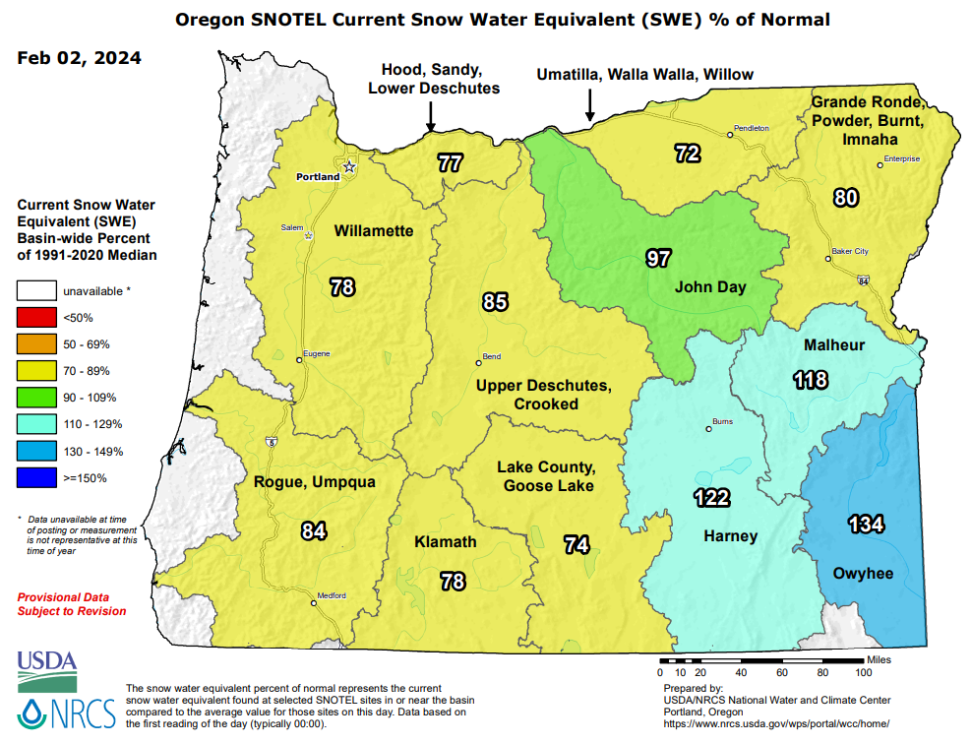
January Snowpack
Notes:
https://www.wcc.nrcs.usda.gov/ftpref/data/water/wcs/gis/maps/or_swepctnormal_update.pdf

Slide 11
Reservoir Storage January
Notes:
Oregon Water Resources Department Bi-Weekly Drought Report https://apps.wrd.state.or.us/apps/wr/wr_drought/current_updates.aspx

Slide 12
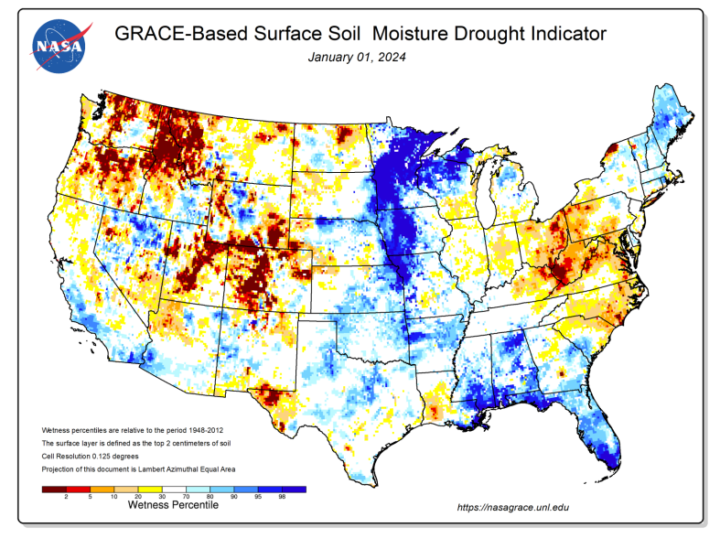

Slide 13
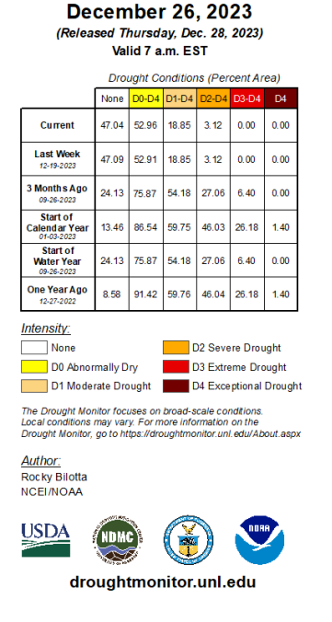
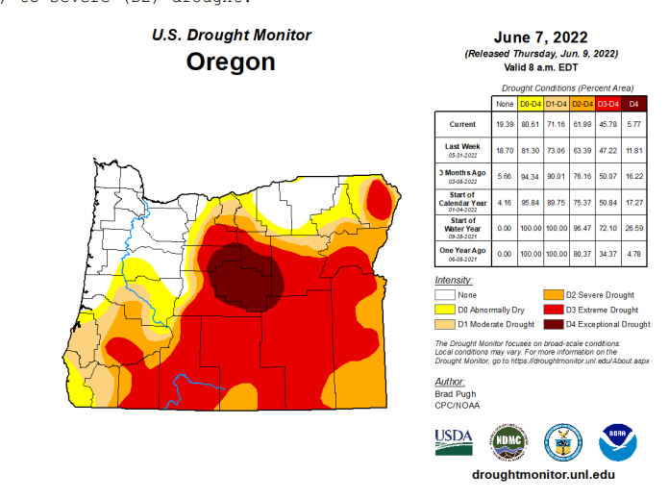
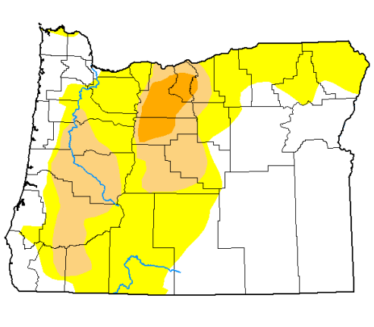
Drought Monitor
“Residential” includes urban and rural areas around the home
City Utility Water and irrigation ditches less guaranteed due to wavering snowpack
Wells drying up due to low aquifer levels
50% + of residential water used for yards
Notes:
Oregon Water Resources Department Bi-Weekly Drought Report https://apps.wrd.state.or.us/apps/wr/wr_drought/current_updates.aspx

Slide 14
INDOOR WATER CONSERVATION

Slide 15
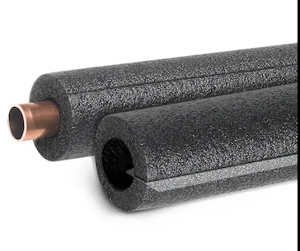
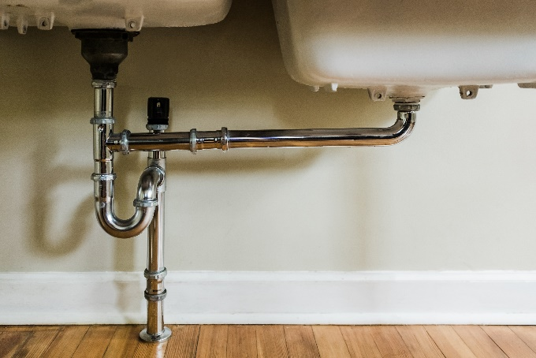
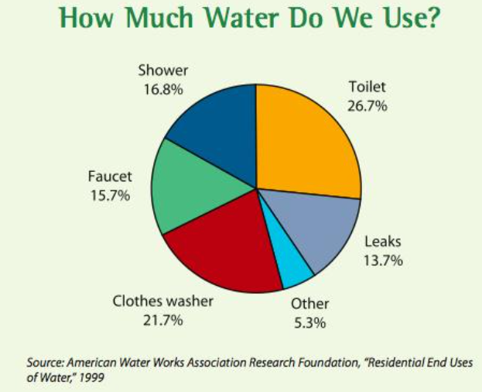
General Indoor Water Conservation
Check faucets and pipes for leaks
Saves 20+ gallons per day
Use your water meter/water sensors to check for hidden water leaks
Install faucet aerators
For about $5-10, water flow from faucets can be cut up to 50%.
Insulate water pipes
Use pre-split foam insulators. Insulate all hot water pipes and the first six feet of cold water pipes.
Notes:
WELLS DON’T REQUIRE METERS, BUT I RECOMMEND INSTALLING A SENSOR/METER TO SEE IF YOU HAVE LEAKS
Check faucets and pipes for leaks
A small drip from a worn faucet washer can waste 20 gallons of water per day.
Use your water meter to check for hidden water leaks
Compare house water meter before and after a two-hour period when no water is being used.
Install faucet aerators
For about $5-10, water flow from faucets can be cut up to 50%.
Insulate water pipes
Easily and affordably insulate pipes with pre-split foam insulators. You'll get hot water faster and save electricity and water. Insulate all hot water pipes — and the first six feet of cold water pipes.

Slide 16
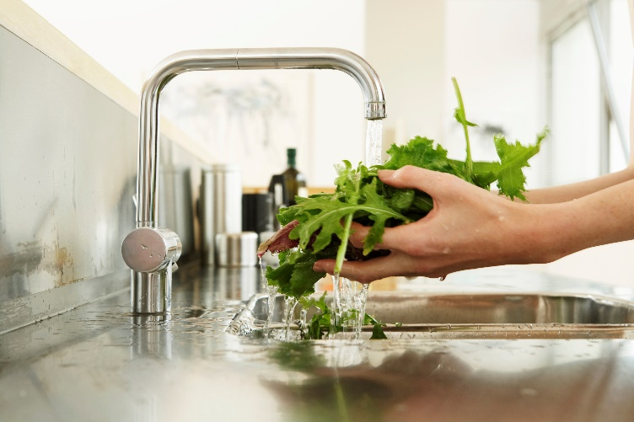
Kitchen Water Conservation
Wait for full loads to run the dishwasher
Update dishwasher to energy efficient brand
Minimize use of kitchen sink garbage disposal units
Keep a container of drinking water in the refrigerator, instead of letting the faucet run until the water cools down
Avoid letting the water run when rinsing vegetables, cleaning dishes, or defrosting food
Notes:
A load of dishes cleaned in a dishwasher can use 37%less water than washing dishes by hand. If you must wash dishes by hand, avoid running the water when scrubbing dishes. Try filling the basin with clean water for rinsing rather than running water for each dish.

Slide 17
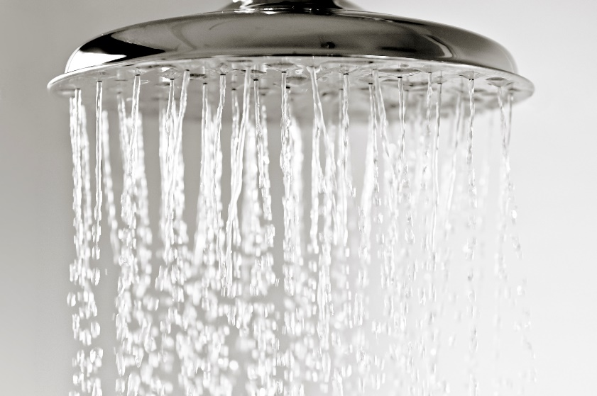
Bathroom Water Conservation
Install water-saving shower heads.
Reduce water usage by 2 to 4 times
Take shorter showers and save many gallons of water.
The average 8-minute shower uses approx. 17 gallons of water.
Check your toilets for leaks.
Save 10,000+ gallons of water/year
Replace old toilet with efficient brand
Save water up to 70%
Turn off the water while you brush
Turn off water while you shave
Notes:
Check your toilets for leaks. A leaky toilet can waste 10,000+ gallons of water/year! Put a bit of food coloring in your toilet tank. If, without flushing, the color begins to appear in the bowl within 30 minutes, you have a leak that should be repaired.

Slide 18
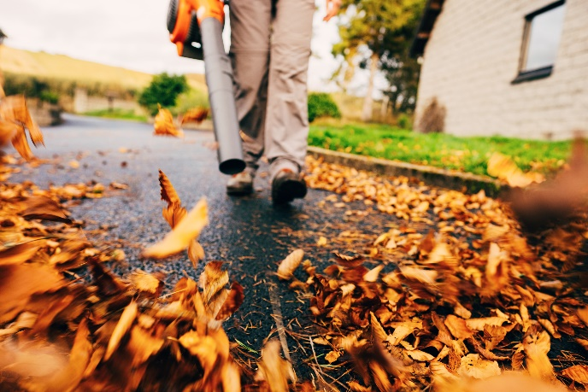
Laundry Room & Indoor/Outdoor Water Conservation
Laundry Room
Replace old washing machines with new energy efficient brands
Use 40-75% less water
Adjust water level to fit load size
Indoor/Outdoor
Graywater
Water from your shower and faucets can be used to flush toilets. Water from washing machines can also be used to water your landscape.
Hosing off outdoor surfaces
Use a broom or battery powered leaf blower instead of a hose to clean off the driveway, patio, or deck.
Limit car washing in driveway, for cleaner streams to go car washes (goes into wastewater treatment).

Slide 19
OUTDOOR WATER CONSERVATION

Slide 20
What Does Residential Use Look Like?
An average Medford residential household uses 2,000-5,000 gallons of water per month (1-2k gallons per person per month)
An average Medford residential house uses around 20,000-25,000 gallons of water in the summer
Notes:
What does water use look like at a residential level?
Even conservative use uses 4x as much water

Slide 21
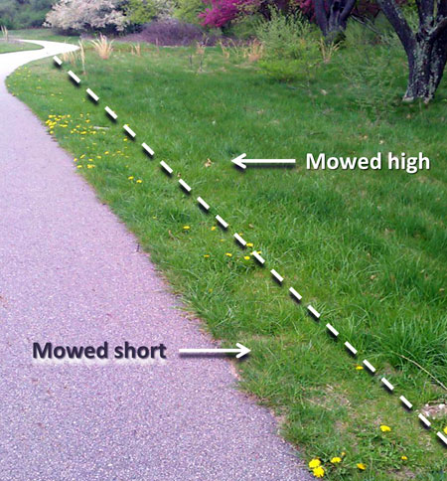
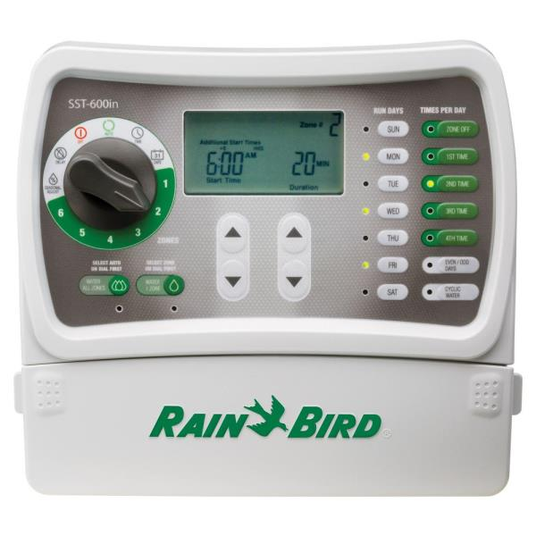
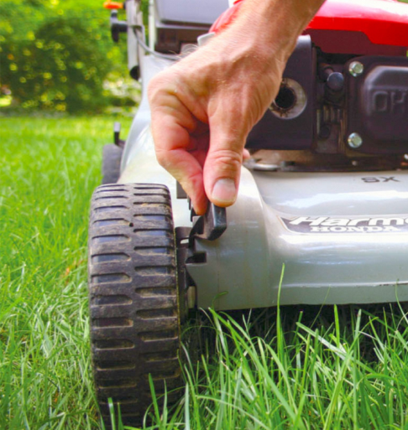
Approaches to outdoor water conservation
Efficient irrigation practices
Pre-season system check-up
Check for leaks
Sprinkler head adjustment
Make sure not oversized
Water frequency planning -consider climate
2. Lawn Maintenance
Mow High – strengthen roots, reduce water needs
Avoid runoff & pollutants
Properly dispose of lawn clippings
Apply pesticides & fertilizers properly if needed
Notes:
Be smarter than the technology
Early mornings before 6am
Hour break between cycles in clay soils
2-3 times a week
How long depends on current weather
Impacts not needed for residential use, more ag/commercial needs
Difference between rotor head and rotor nozzle- multiple streams of water over an area as opposed to one stream; can be more efficient
This matters when we look at sprinkler timing

Slide 22
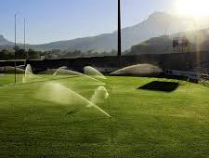
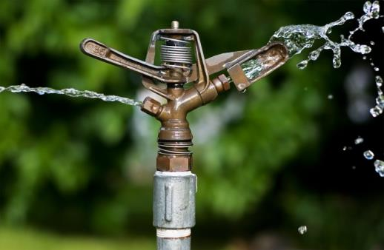
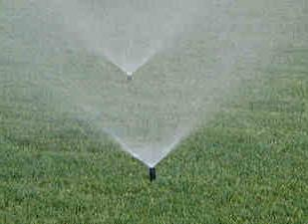
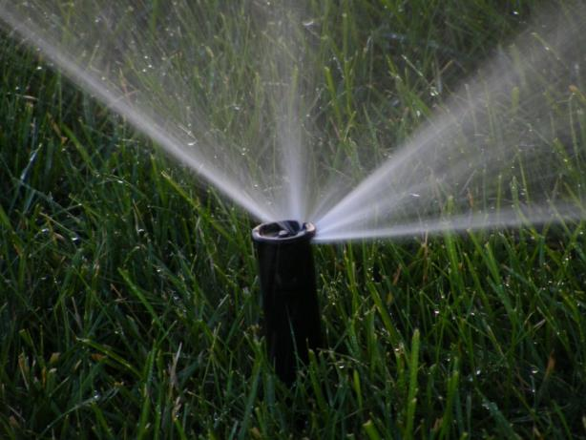
Types of Sprinkler Heads
Rotor Head
Impact
Spray
Rotor Nozzle
Notes:
Impacts not common in our neighborhood
Difference between rotor head and rotor nozzle- multiple streams of water over an area as opposed to one stream; can be more efficient
This matters when we look at sprinkler timing

Slide 23
Root Depth and Water Storage
“Each 1% increase in soil organic matter helps soil hold 20,000 gallons more water per acre.” -NRCS

Slide 24
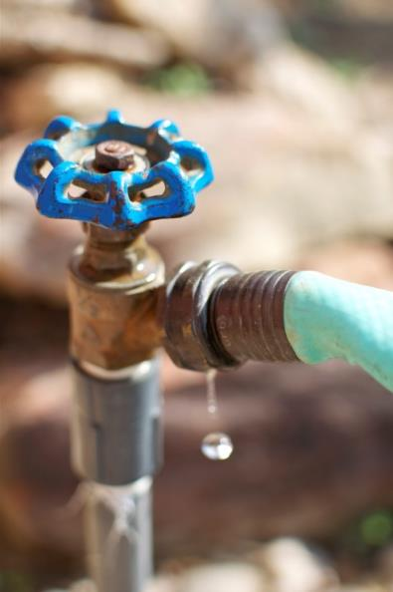
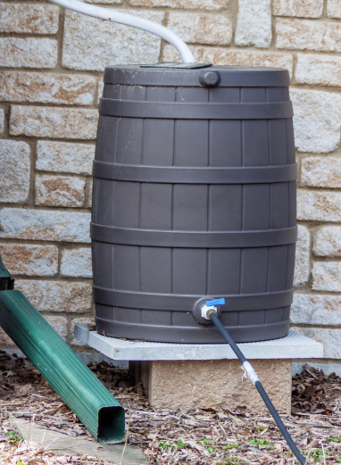
Approaches to outdoor water conservation
3. Water Resource Check-ups
Check pipes for leaks
Maintain wells – install level sensors
4. Install water storage tanks
Supplemental storage for wells & irrigation
Rainwater catchment storage

Slide 25
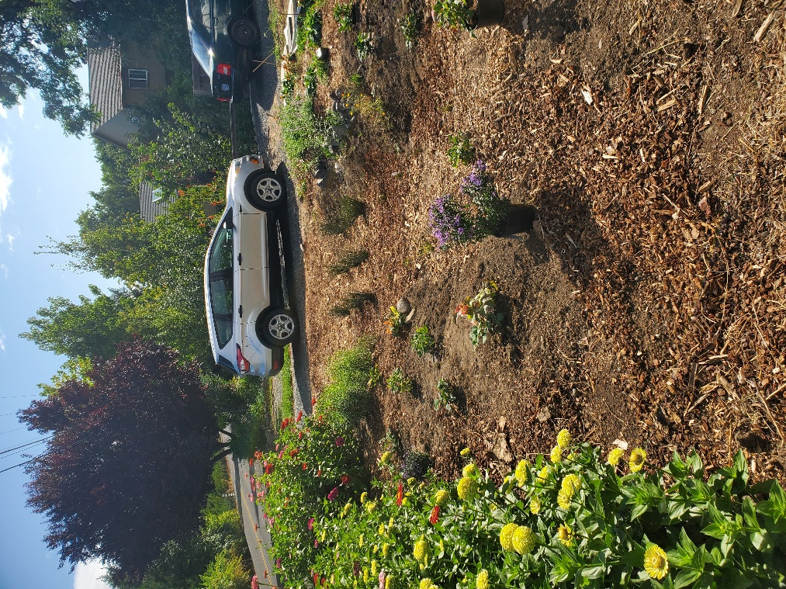
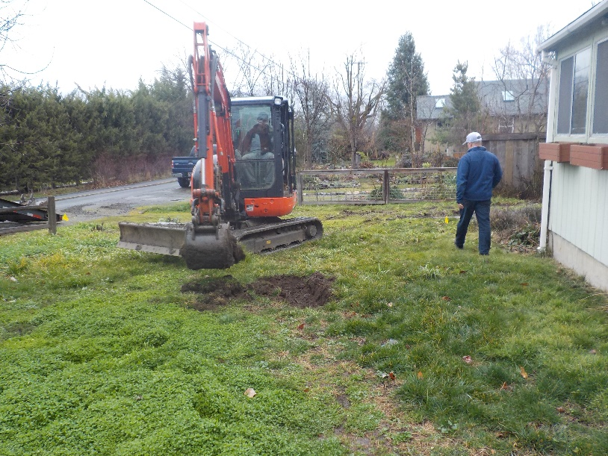
Approaches to outdoor water conservation
5. Lawn Replacement
Replace lawn with water wise species (implement xeriscape techniques)
6. Install other stormwater features
Capture & filter water (e.g. rain gardens & bioswales)

Slide 26
WATER- WISE LANDSCAPING

Slide 27
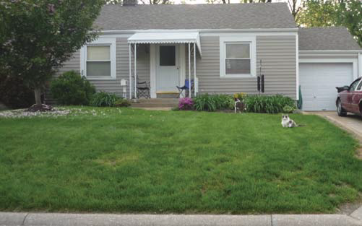
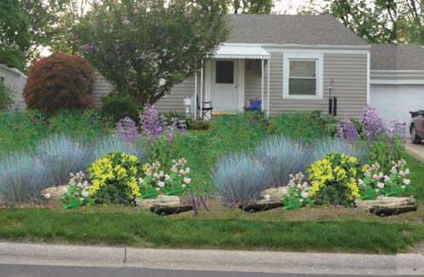
What is Xeriscaping?
Also known as “water-wise landscaping”, a xeriscaped yard strives to use less water than a traditional yard. A xeriscaped yard varies greatly, from drought-tolerant, desert-loving plants, to lush varieties.

Slide 28
Steps to Xeriscaping
1. Plan and Design
2. Create Practical Turf
3. Group Similar Plants
4. Improve the Soil
5. Mulch
6. Efficient Irrigation
7. Maintain the Landscape
Notes:
In the Urban Living Handbook we call them “principles”
There are 7 steps to xeriscaping. My presentation will cover and explain each step. I will ask if anyone has any questions after each step. If I forget feel free to remind me. Q and A session due to time constraints.

Slide 29
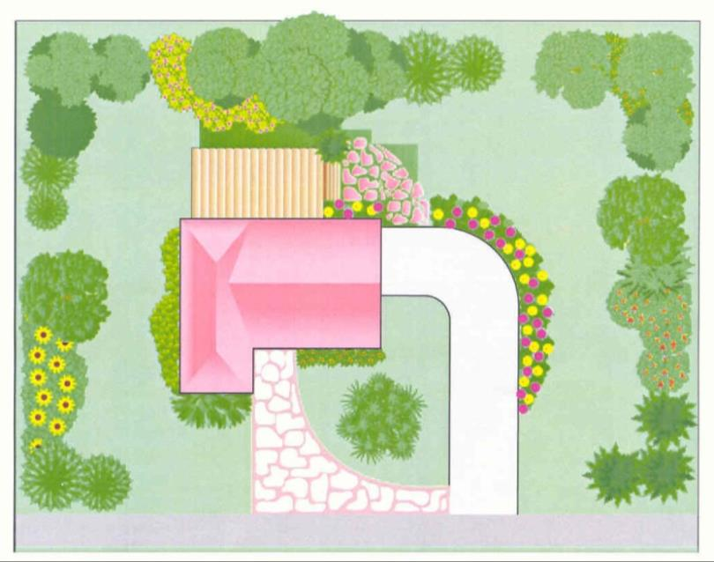
1) Plan and Design
Create a site map
Notes:
Planning Considerations
Cardinal Directions
Sunny/Shady areas
Flooding/Erosion
Consider Soils information
Laws/permits
Preserve views
Depth to water table (seasonal)
Distance to forest or surrounding properties
Consider Region
Sun/Shade
Temperature
Precipitation
Humidity
Wind
Topography
Budgeting
Get quotes

Slide 30
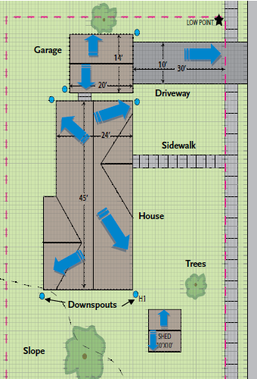
Create a Site Map
What to include…
Dimensions of house/garage/shed
Downspout locations
Paved areas
Slopes & Low Spots
Fences and nearby properties
Trees, shrubs, raised beds, lawn
Storm drain locations on street
AC unit, water feature, pool, hot tub
Water, electric, gas, septic lines
Notes:
DISCLAIMER: STEP 1 IS THE MOST IMPORTANT. YOU WILL LIKELY NEED TO CONSIDER OTHER STEPS WHILE PLANNING, AND THEREFORE SOME STEPS MAY BE OUT OF ORDER.
Downspouts- mark all downspouts on map and note whether they drain to the storm drain by the way of an underground pipe or send rainwater out into the yard
Paved Areas-walkways, driveways, city sidewalks
Soils-permeability, soil type, (more in step 4)
Rain Flow- direction rain water runs off roof, paved/hard surfaces, and to each of the slopes/hills/low spots (best to take note when it is rainy, or simulate with a garden hose)
Draw yard and features to scale
Place/group plants according to their light needs and water requirements to avoid over/under-watering; taller plants in back, lighter plants in front; give each plant room to grow

Slide 31
Plan Your Budget & Timeline
Avoid future surprise costs
Determine scope of project based on financial budget and time to allocate
Call around and get quotes
Nurseries and supply stores (plant prices, mulch, gardening supplies, drip irrigation)
If hiring labor out (contractors/landscapers)
Create budget worksheet
Xeriscaping ranges $5-20+ dollars/square foot, depends on materials
Plan removal techniques – hand removal, sod cutter, solarizing
Summer removal & fall planting is best

Slide 32
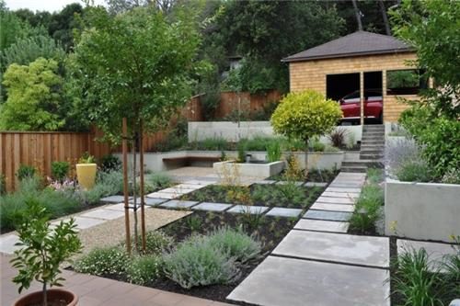
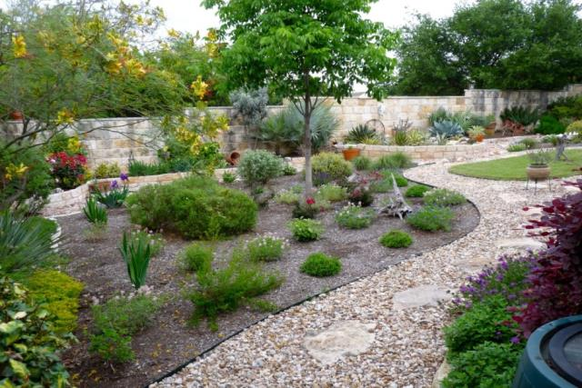
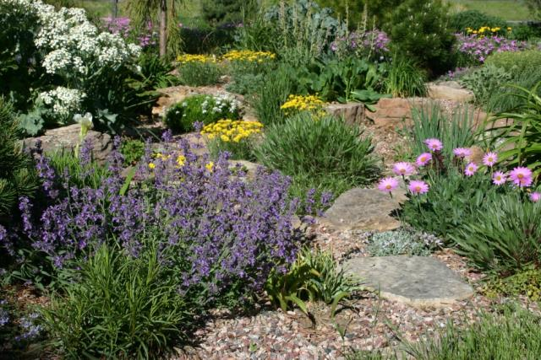
Choose a Design
Formal
Formal
Informal
Natural
Informal
Natural
Notes:
Source:https://books.google.com/books?hl=en&lr=&id=yMdu9QhIzHMC&oi=fnd&pg=PR7&dq=xeriscape&ots=6RXYWe0A6L&sig=q03YzN1Sn6AWc3kZZ49sOCRO2qU#v=onepage&q=xeriscap&f=false
Formal
Source: Landscaping Network
Informal
Source: The Joshua Tree & Landscape Company

Slide 33
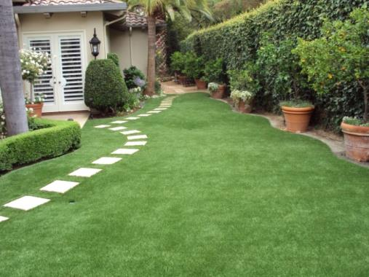
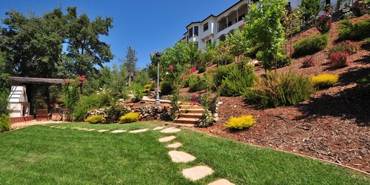
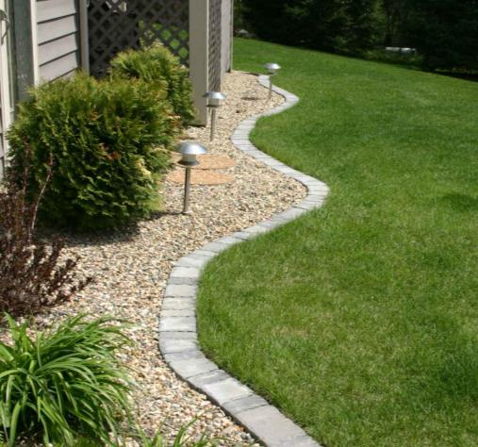
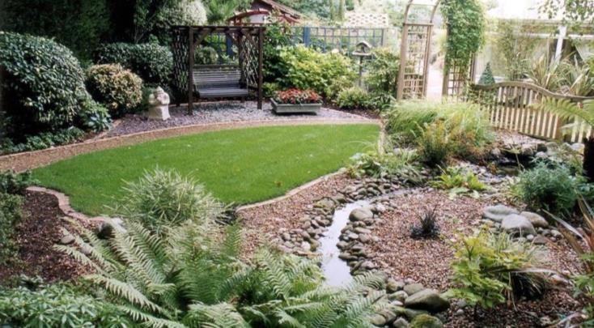
2) Create Practical Turf
Notes:
Http://landscape-design-in-a-day.com/garden-tips/my-top-5-stepable-plants-for-paths
Determine areas of use
No-mow turf (fescues)
Artificial grass
Groundcover instead of lawn
Possible areas to transform
Direct sun
Direct shade
Hillsides
Regular pathways
Street/Sidewalk border

Slide 34
Create Practical Turf
Xeriscaping is about creating practical turf and being water-wise, not necessarily removing all lawn in one’s yard.
For example:
Replace lawn with shade-tolerant native plants in the shady areas of your yard
Replace lawn with native plants helpful for erosion control along a hillside.
Consider artificial turf alternatives if you desire a lawn aesthetic.

Slide 35
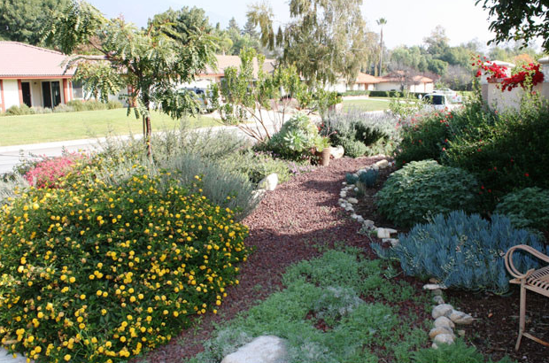
3) Group Similar Plants
Notes:
The following lists were compiled using the “Water-Efficient Plants for the Willamette Valley”, and then fact-checking natives using the Oregon Flora Project for the Siskiyou Region
Water-wise plants (low water use)
Native plants recommended
Research soil fertility preference of native plants
Plant in the fall to give drought-tolerance a change to establish
Water native plants 2-3 years until established
Microclimates
Trees, shrubs, flowers, groundcover/lawn
Plants to pick are dependent on the site (slope/area) landscaping style, water needs, and personal preference
Overall, native, low water use, sun/drought tolerant plants are recommended

Slide 36
Group Similar Plants
It is important to group plants together according to their micro-climate (sun exposure, water requirements, soil type).
For example…
Put plants that have higher water needs next to down-spouts, in low-lying areas, or areas that don’t drain as quickly (such as clay soils).
Put plants that prefer sunlight and dry conditions on elevated areas or those with south or west exposures.
Two Different Xeriscape Designs
Mulched xeriscape design, softer water-wise plants
Rocky xeriscape design, hardy/desert plants

Slide 37
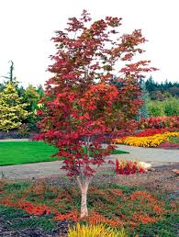
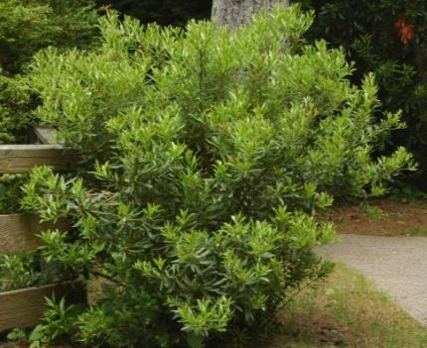
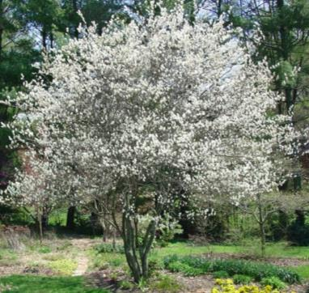
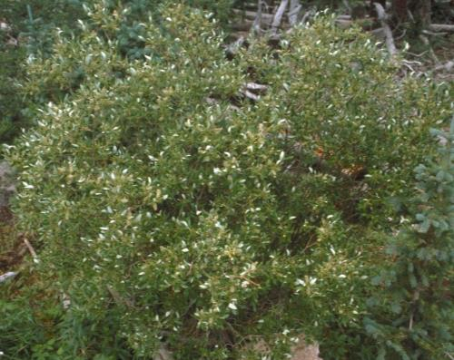
Mulched Design - Trees
Pacific Way Myrtle
Serviceberry
Vine Maple
Oregon White Oak
Scouler Willow
Notes:
https://www.oregon.gov/owrd/docs/Willamette_Valley_Water_efficient_Plants.pdf
These trees get large…not always recommended for smaller properties (but you could buy a bonsai trees)
Maple, oak, and pine may be the most practical

Slide 38
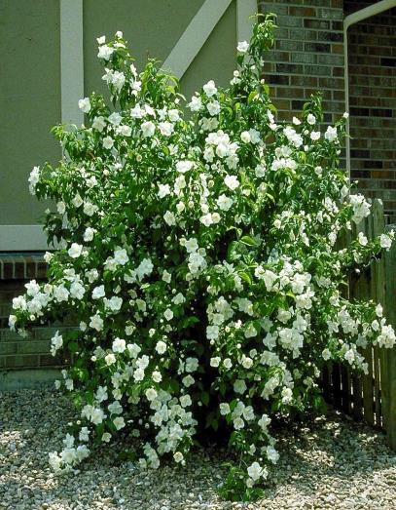
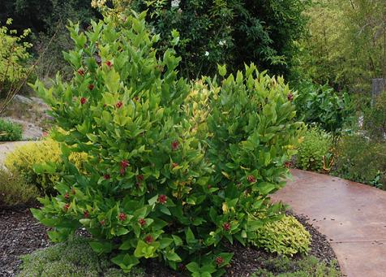
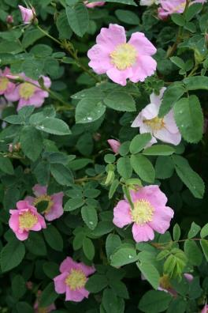
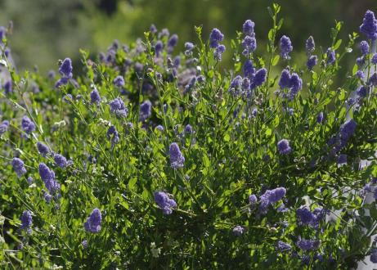
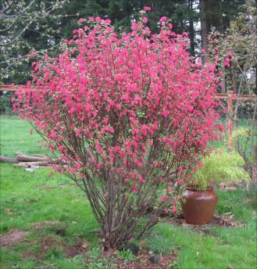
Mulched Design - Shrubs
Mock Orange
Sweet Shrub
Nootka Rose
Blue Blossom
Red Flowering Currant

Slide 39
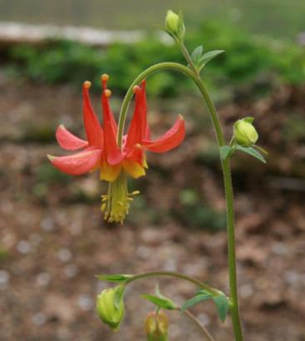
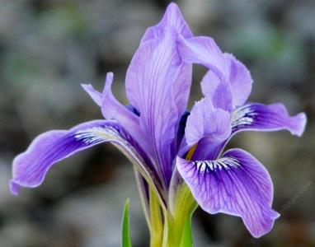
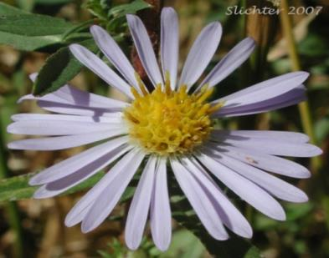
Mulched Design - Flowers
Douglas Iris
Douglas Aster
Red Columbine
California Poppy
Cascade penstemon

Slide 40
Mulched Design - Grass
California Fescue
Tufted Hairgrass
Idaho Fescue

Slide 41
Rocky Design – Shrubs/Flowers
Sagebrush
Pussytoes
Iceplant
Pasque Flower
Thyme
Rock Cress

Slide 42
Rocky Design – Cacti and Succulents
Prickly Pear
Mountain Ball Cactus
Spiny Star
Yucca
Stonecrop
Hens and Chicks

Slide 43
4) Improve the Soil
Notes:
Clay soil is likely alkaline (high pH)
Have some soil maps
Test soil to determine type/texture & infiltration
Needed amendments
Use organic matter
Composted manure
General mixed compost
Xeriscaping in clay, sandy, and silty soils…(differs)
Clay is most difficult (holds water longer)

Slide 44
Determine Soil Type – Hand Test

Slide 45
Determine Soil Type – Soil Survey
158 B - Ruch gravelly silt loam, 2 to 7 percent slopes, low precip
Typical profile
A - 0 to 7 inches: gravelly silt loam
Bt - 7 to 70 inches: loam
Depth to restrictive feature: More than 80 inches
Drainage class: Well drained
Depth to water table: More than 80 inches
158D—Ruch gravelly silt loam, 7 to 20 percent slopes
Typical profile
A - 0 to 7 inches: gravelly silt loam
Bt - 7 to 70 inches: loam
Depth to restrictive feature: More than 80 inches Drainage class: Well drained
Depth to water table: More than 80 inches
Source: USDA Web Soil Survey

Slide 46
Soil Amendments
Clay: coarse sand, compost, peat moss
Sand: humus, peat moss, sawdust, rich clay, aged manure
Silt: coarse sand, compost, aged manure, straw
Source: S.O. Compost
Image Source: Colorado State University
Notes:
DEFINITIONS
Peat – accumulation of particularly decayed vegetation or organic matter in a water-saturated environment in the absence of oxygen
Vermiculite – hydrous phylosillicate; allows aeration and water retention
Perlite – volcanic glass, white; allows aeration and water retention

Slide 47
5) Mulch
Notes:
Retains moisture
4 to 6 inches recommended
Wood, gravel
Suppresses weeds
Ex: western red cedar

Slide 48
Types of Mulch
Source: OSU Extension

Slide 49
6) Efficient Irrigation
Notes:
Brief…clint will talk about this

Slide 50
Efficient Irrigation
Water in the morning or evening when the wind is still and evaporation rates are lowest.
Use drip, micro-sprays, bubblers, or emitters to deliver water. When sprinklers are necessary, use sprinklers that keep the water close to the ground, and use rotary (side-to-side) or stationary sprinkler heads.
Inspect the irrigation system regularly for leaks, broken emitters
Change your irrigation schedule with the weather. Generally, you should do this at least once a month. Turn off your irrigation if a storm moves in, and don’t turn it back on until plants need to be watered
Irrigate new landscaping for at least 2 years to establish

Slide 51
Sprinkler Types
Grass areas:
Spray Sprinklers
Rotor Sprinklers
Planting Beds:
Drip emitters
Micro-sprays
Notes:
Question to ask class: Which one is which?
Source: http://www.fcgov.com/utilities/img/site_specific/uploads/water-wise_lawn_care_booklet_6-14_update_for_press.pdf
Spray sprinklers are stationary and emit water in a fixed fan-shaped pattern. Generally spray heads deliver one and a half inches of water per hour, but can deliver ¼ inch of water in 7-10 mins
Rotor sprinklers can take much longer to water. Generally they deliver ½ inch of water per hour. ¼ inches of water in 20-30 mins
Drip emitters deliver water at a slow and constant rate, 1-2 gallons per hour; connect to distribution tubing
Microsprays spray water over a small specified area

Slide 52
7) Maintain the Landscape
^Conventional Lawn
Source: Maintaining a Healthy Lawn in Western Oregon, VanDerZaden & Cook, OSU 2001
Trim bushes/trees
Weeding/deadheading perennials
Mow turf areas high
Check pipes and hoses for leaks

Slide 53
Resources

Slide 54
Well Water Resources
OWRD/ OHA Well Water Handbook
Page 9-10 has water conservation tips
OWRD Groundwater and Wells Website
https://www.oregon.gov/OWRD/PROGRAMS/GWWL/Pages/default.aspx

Slide 55
JSWCD Website

Slide 56
JSWCD Website

Slide 57
Water-Wise Websites
Medford Water Commission
http://www.medford.watersmartgardening.com/
City of Ashland
https://www.ashlandsaveswater.org/
Includes…
Yard tours
Plant lists
Gardening Ideas
Lawn Alternatives
Design Tips
Watering guide/irrigation
Helpful and detailed information for landscaping and gardening

Slide 58
Medford Water Commission
https://www.medfordwater.org/Files/2021%20Sample%20Lawn%20Watering%20Schedule.pdf

Slide 59
Medford Water Commission
https://www.medfordwater.org/Files/2021%20Sample%20Lawn%20Watering%20Schedule.pdf

Slide 60
Oregon’s Integrated Water Resources Strategy
Statewide framework for meeting Oregon’s Water Needs
Currently being updated
Had community meetings for public comment
Draft should be available for public review and comment in March 2024
https://www.oregon.gov/owrd/programs/planning/iwrs/pages/default.aspx
Notes:
https://www.oregon.gov/owrd/WRDPublications1/2017_IWRS_Final.pdf

Slide 61
Questions?
Kora Mousseaux
Community Water Resource Conservationist
Jackson Soil & Water Conservation District
541-630-0718
kora.mousseaux@jswcd.org

